Slide 1
Traceability Addin
For Dynamics 365 SCM ( and other stuff )

Slide 2
Agenda
Intro
Core concepts
Features and capabilities
Benefits of Traceability add in
Licensing
Scenarios

Slide 3

Nathan Clouse
Technical Architect
Armanino
Microsoft Business Applications MVP (5x)
www.atomicax.com
www.dynamics.fo

Slide 4

What is the Traceability Add in?
Tracing tool – data collection and reporting
What RMs what into what products
What batches or serials are tied to a FG
Where a product, RM, WIP, ended up
What products may be affected by a “bad”, product, RM, WIP, or FG
Forward tracing and Backward Tracing

Slide 5
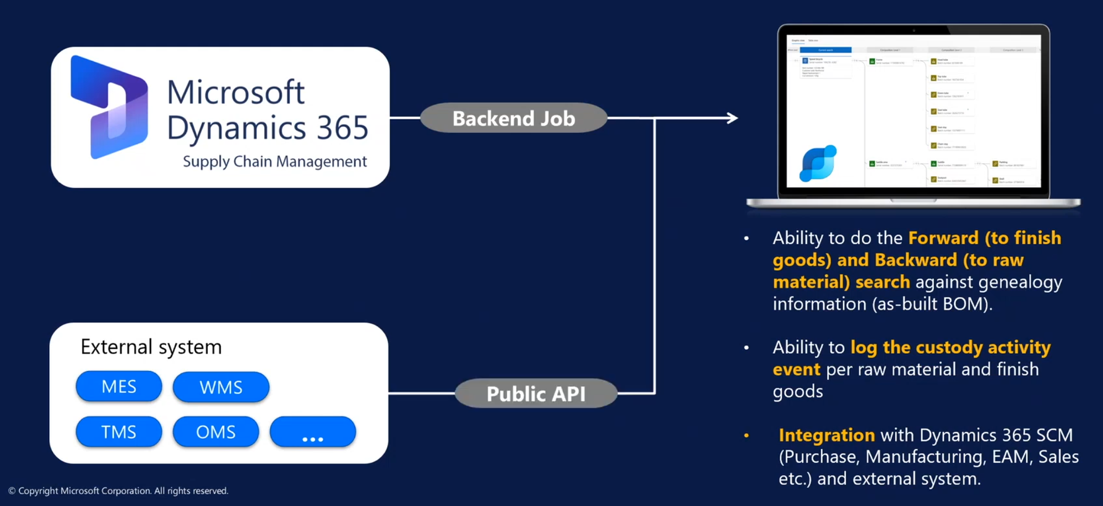
How does it work?

Slide 6
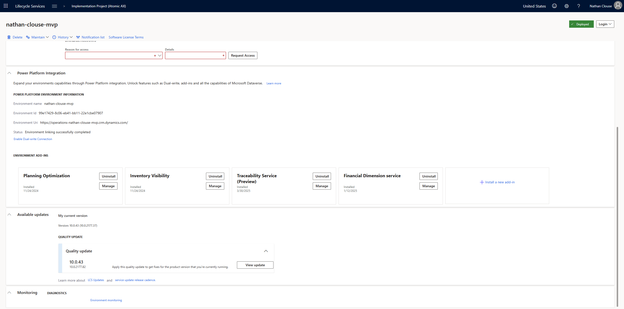
Where is it?

Slide 7
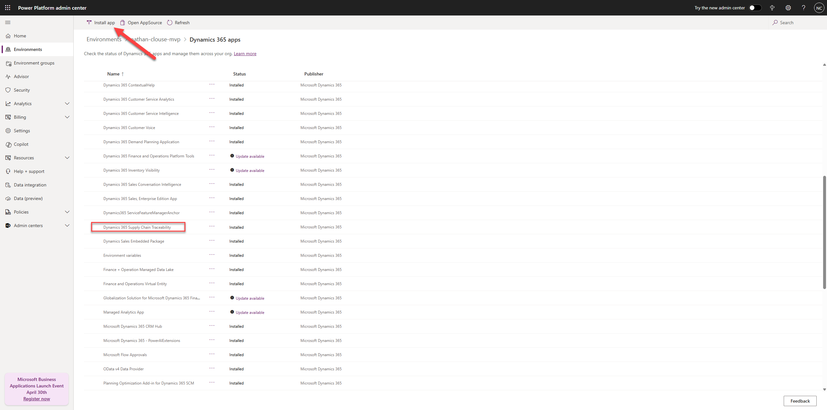
Where is it?

Slide 8
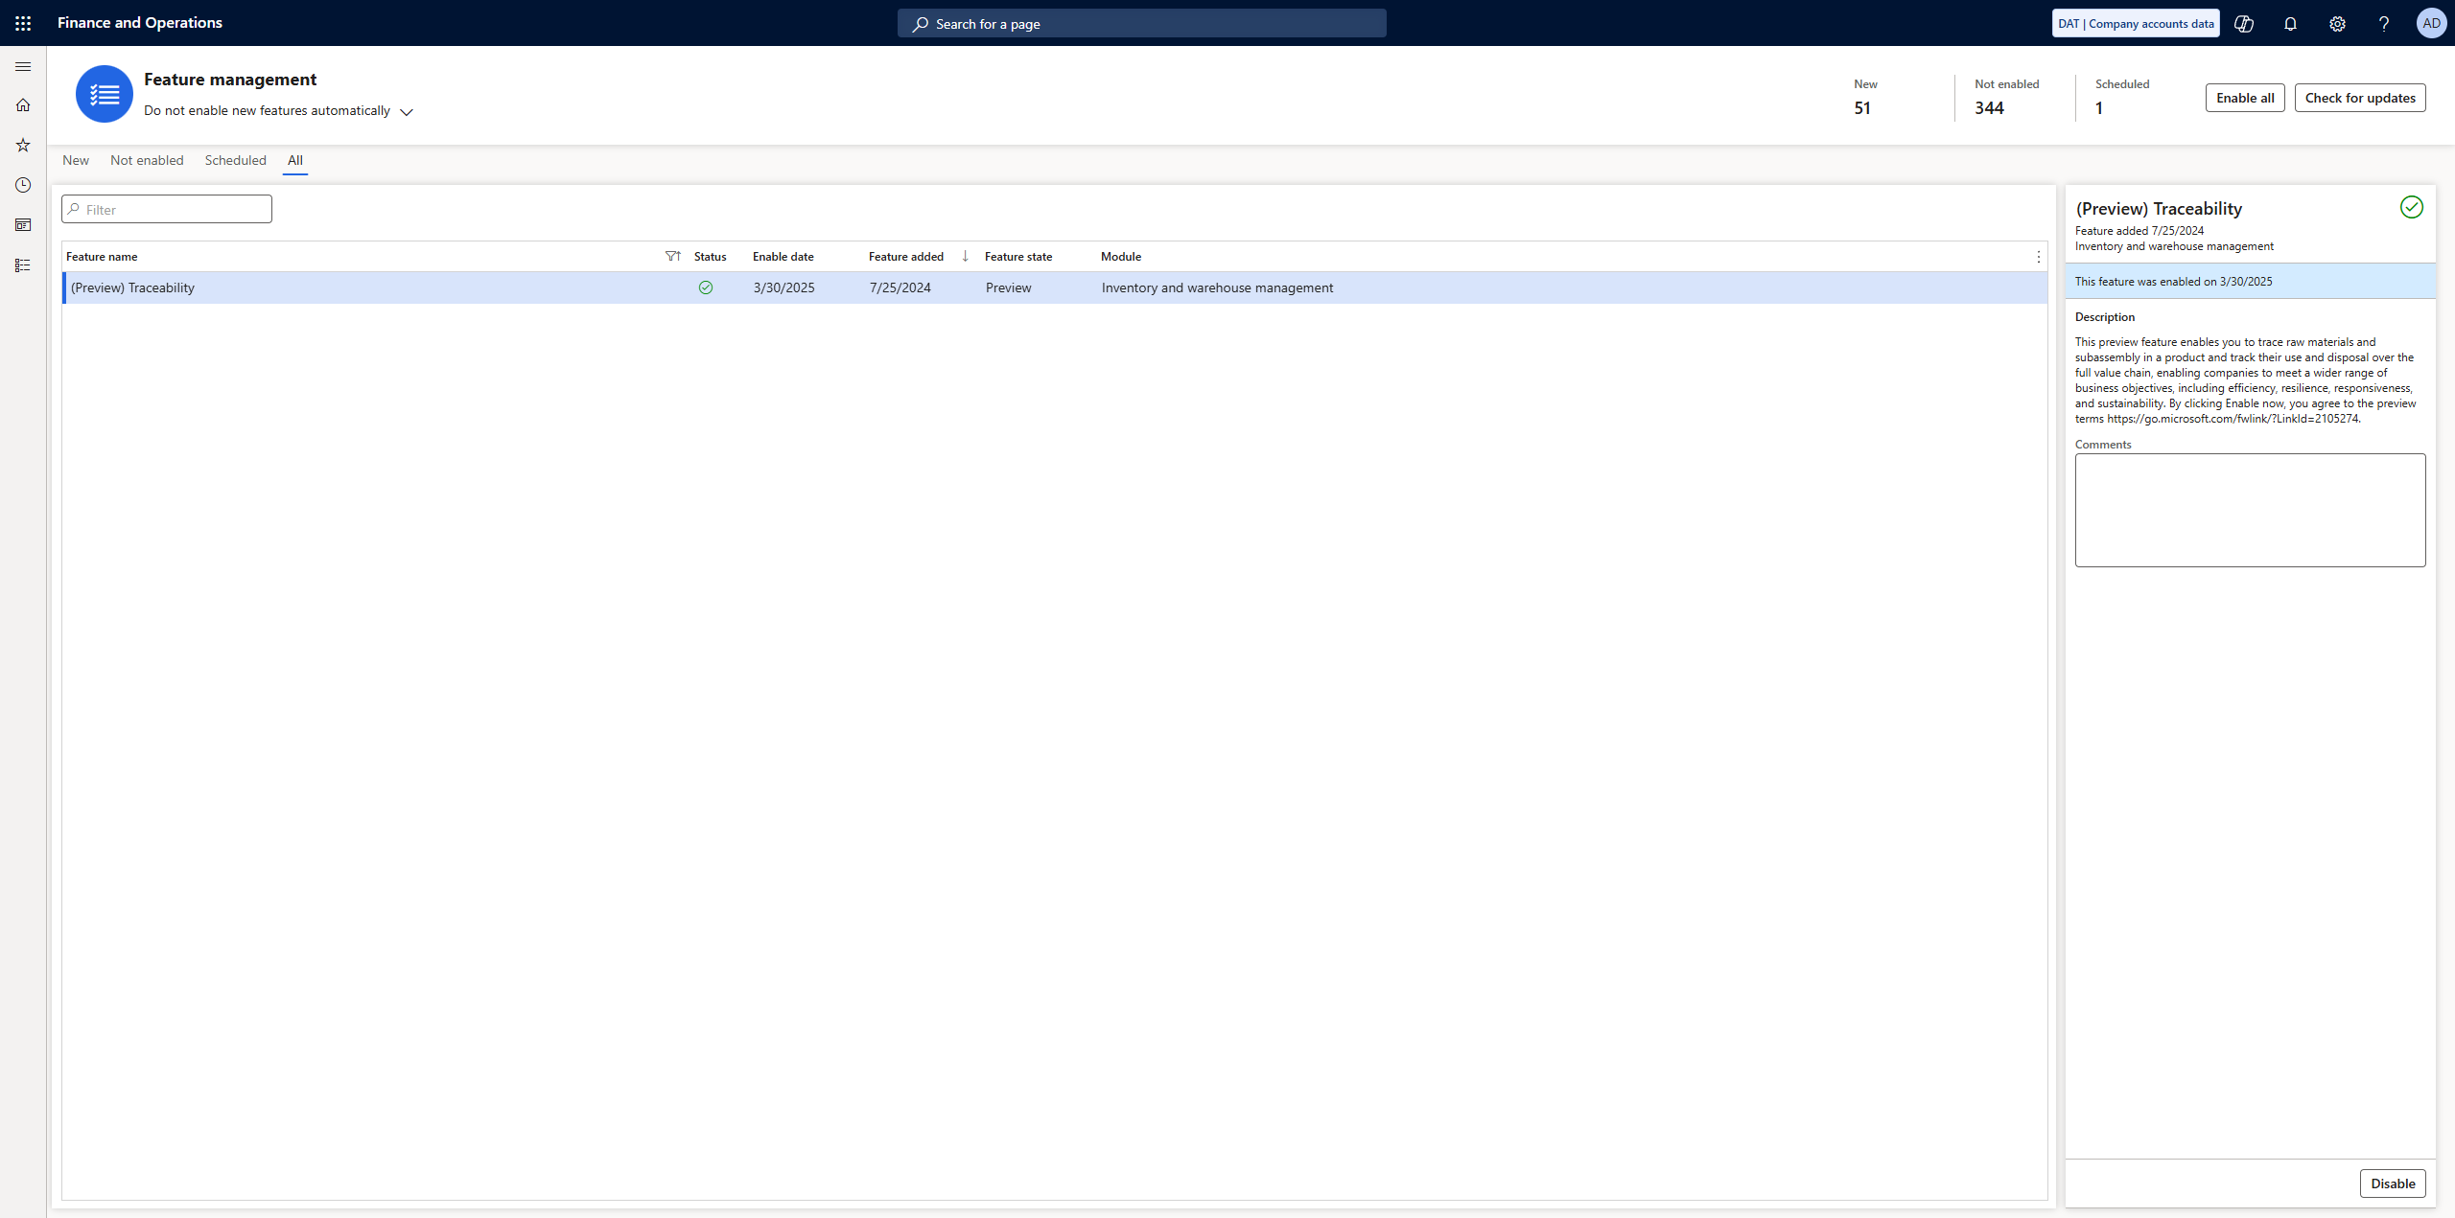
Enable Feature

Slide 9
Problems Solved
What happened?
As-built vs maintained BOM
Activities access SCM life cycle
How did it happen?
Time, operator, activity type, activity code, and data collection
Which things are impacted?
Where-used report for serial, batch, lot, or asset number

Slide 10

Features
Accurate tracking of raw materials and subassemblies throughout the value chain.
As-built Bill of Materials (BOM) registration for documenting product composition.
Forward and backward search functionalities to trace material consumption and identify impacted goods.
Public API for integration with external systems.
Integration with the production floor execution interface for real-time data capture.

Slide 11

Key Terms
Custody Event
“Something Happened”
Genealogy Event
“Something Changed”

Slide 12
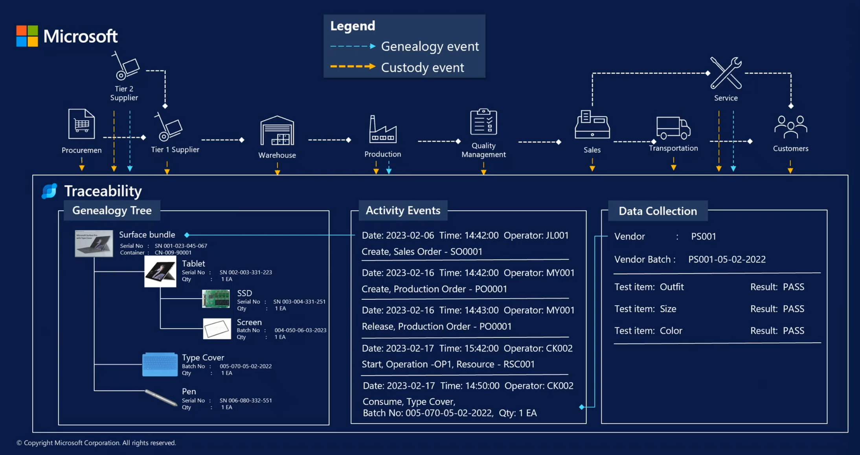

Slide 13


Feature Callout
“Track and Trace”
https://learn.microsoft.com/en-us/dynamics365/release-plan/2024wave1/finance-supply-chain/dynamics365-supply-chain-management/track-trace-serial-batch-numbers-manufacturing

Slide 14

Benefits
Enhanced product lifecycle tracking and visibility.​
Improved product quality through detailed genealogy insights.​
Reduced time and cost associated with product recalls.​
Increased regulatory compliance and ease of passing audits.​
Strengthened customer trust and satisfaction.

Slide 16
Purchase Order
Batch

Slide 17
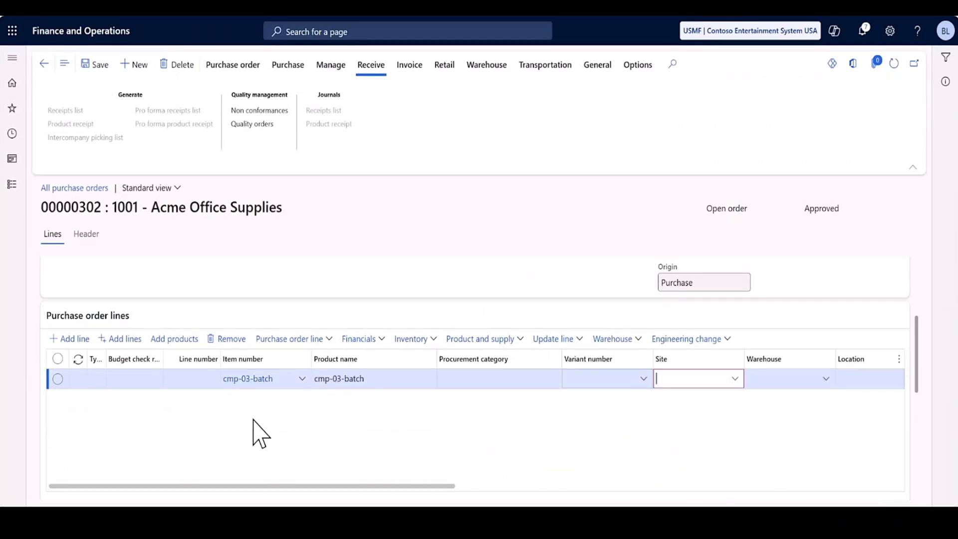

Slide 18
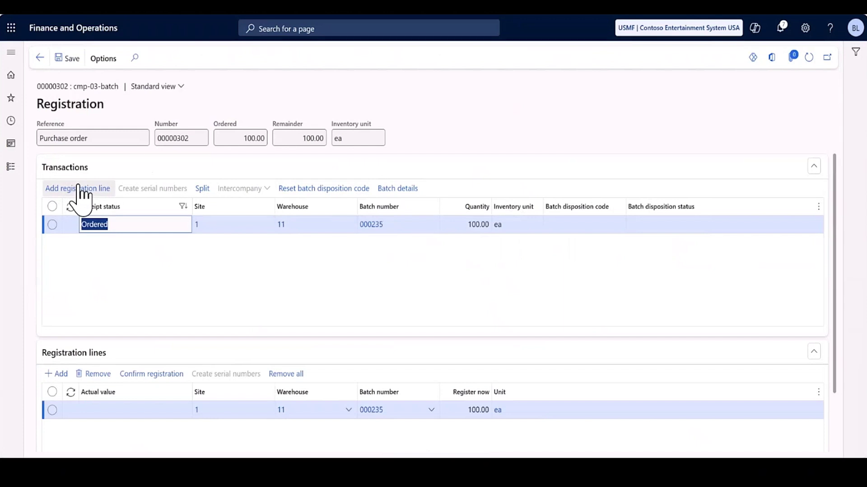

Slide 19
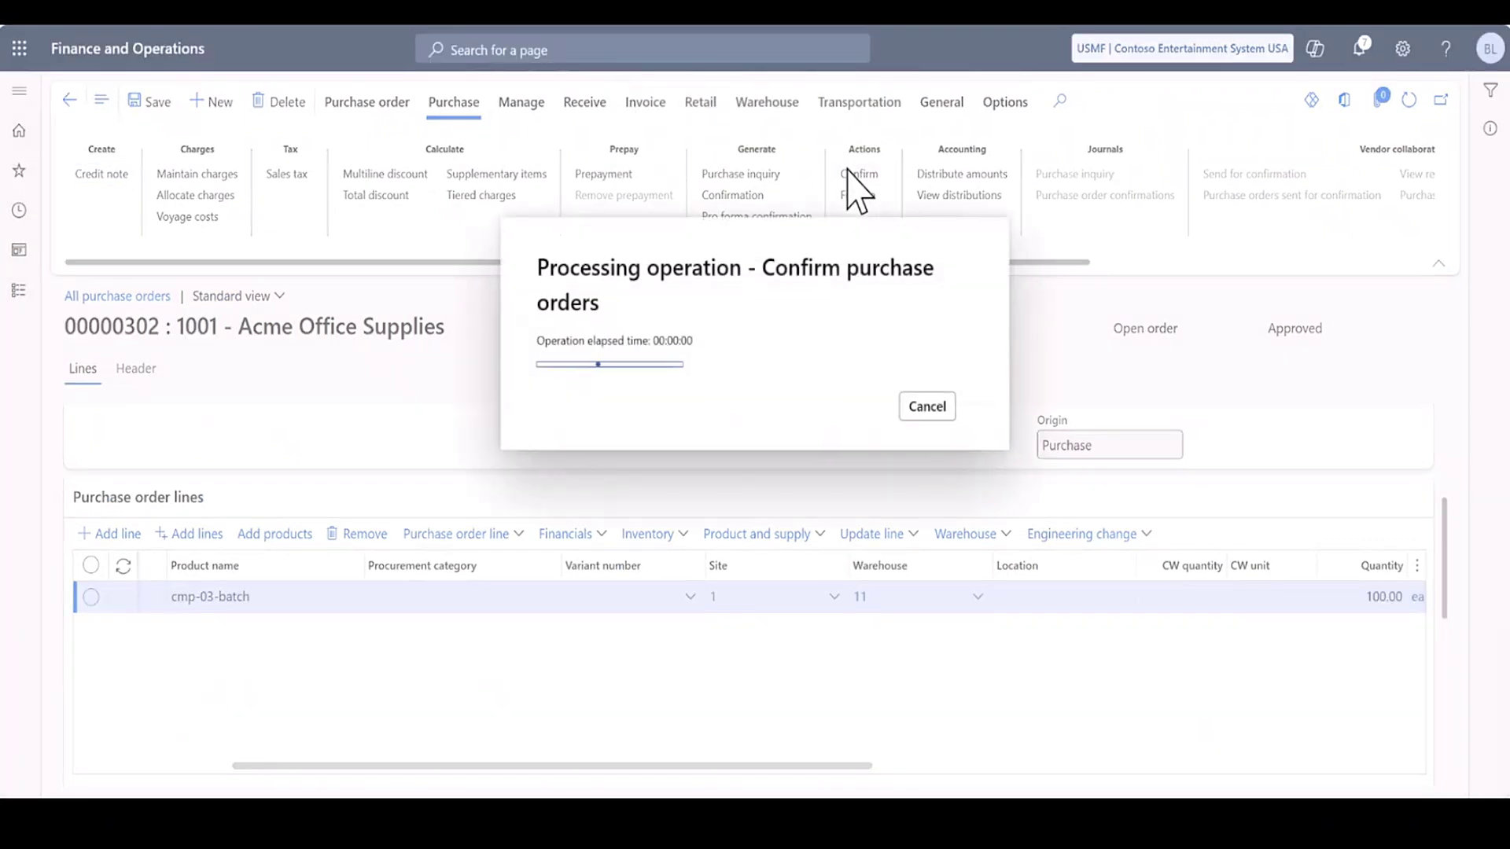

Slide 20
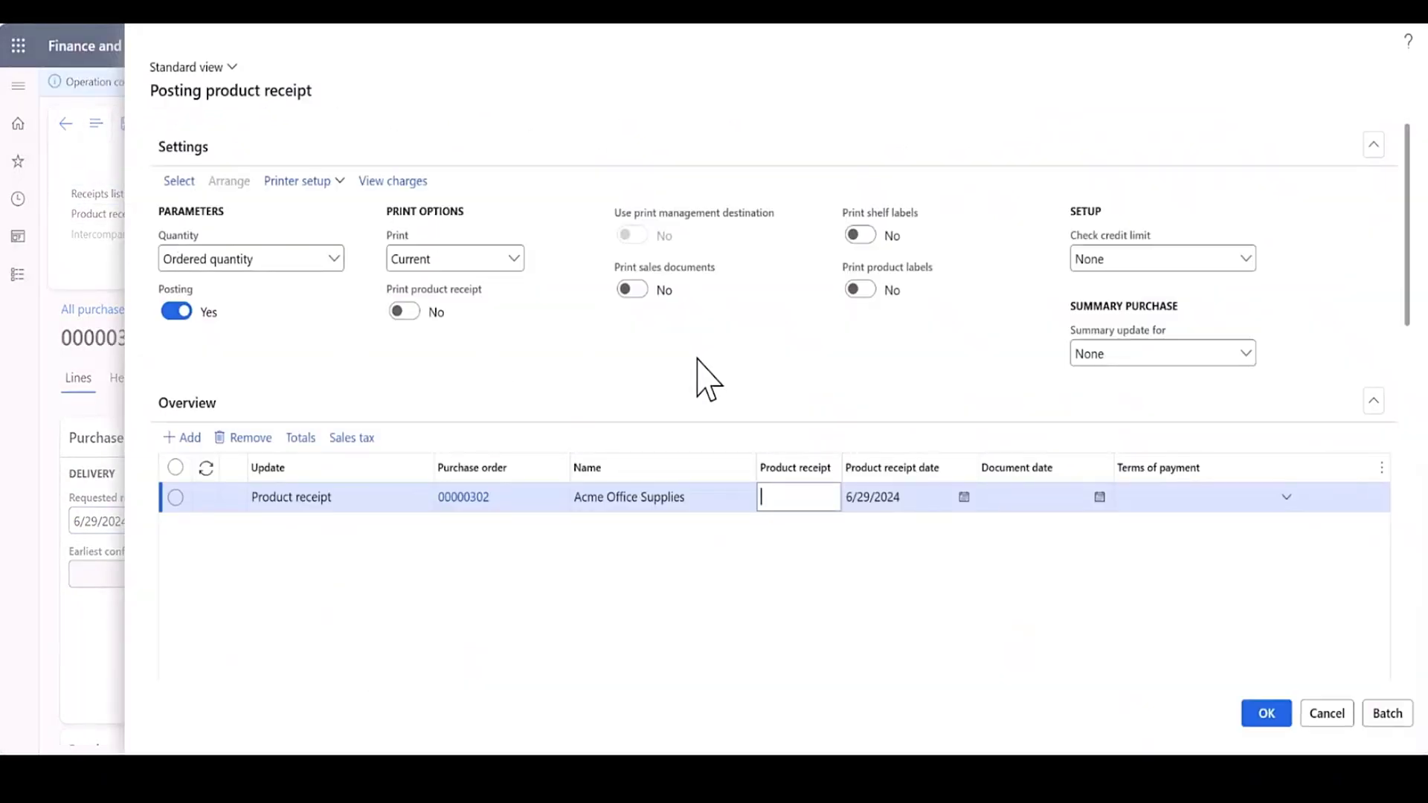

Slide 21
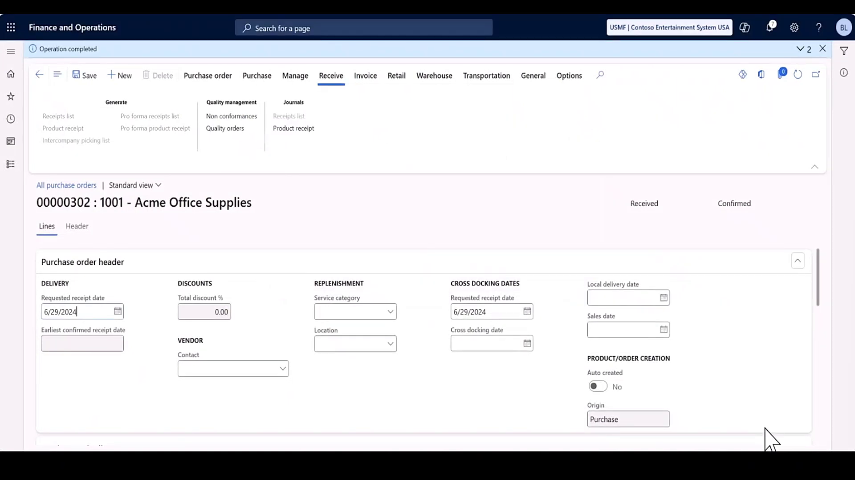

Slide 22
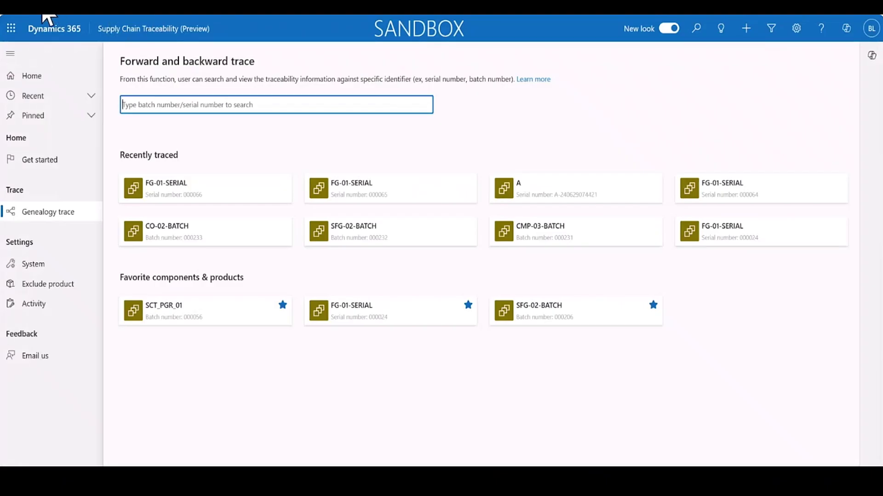

Slide 23
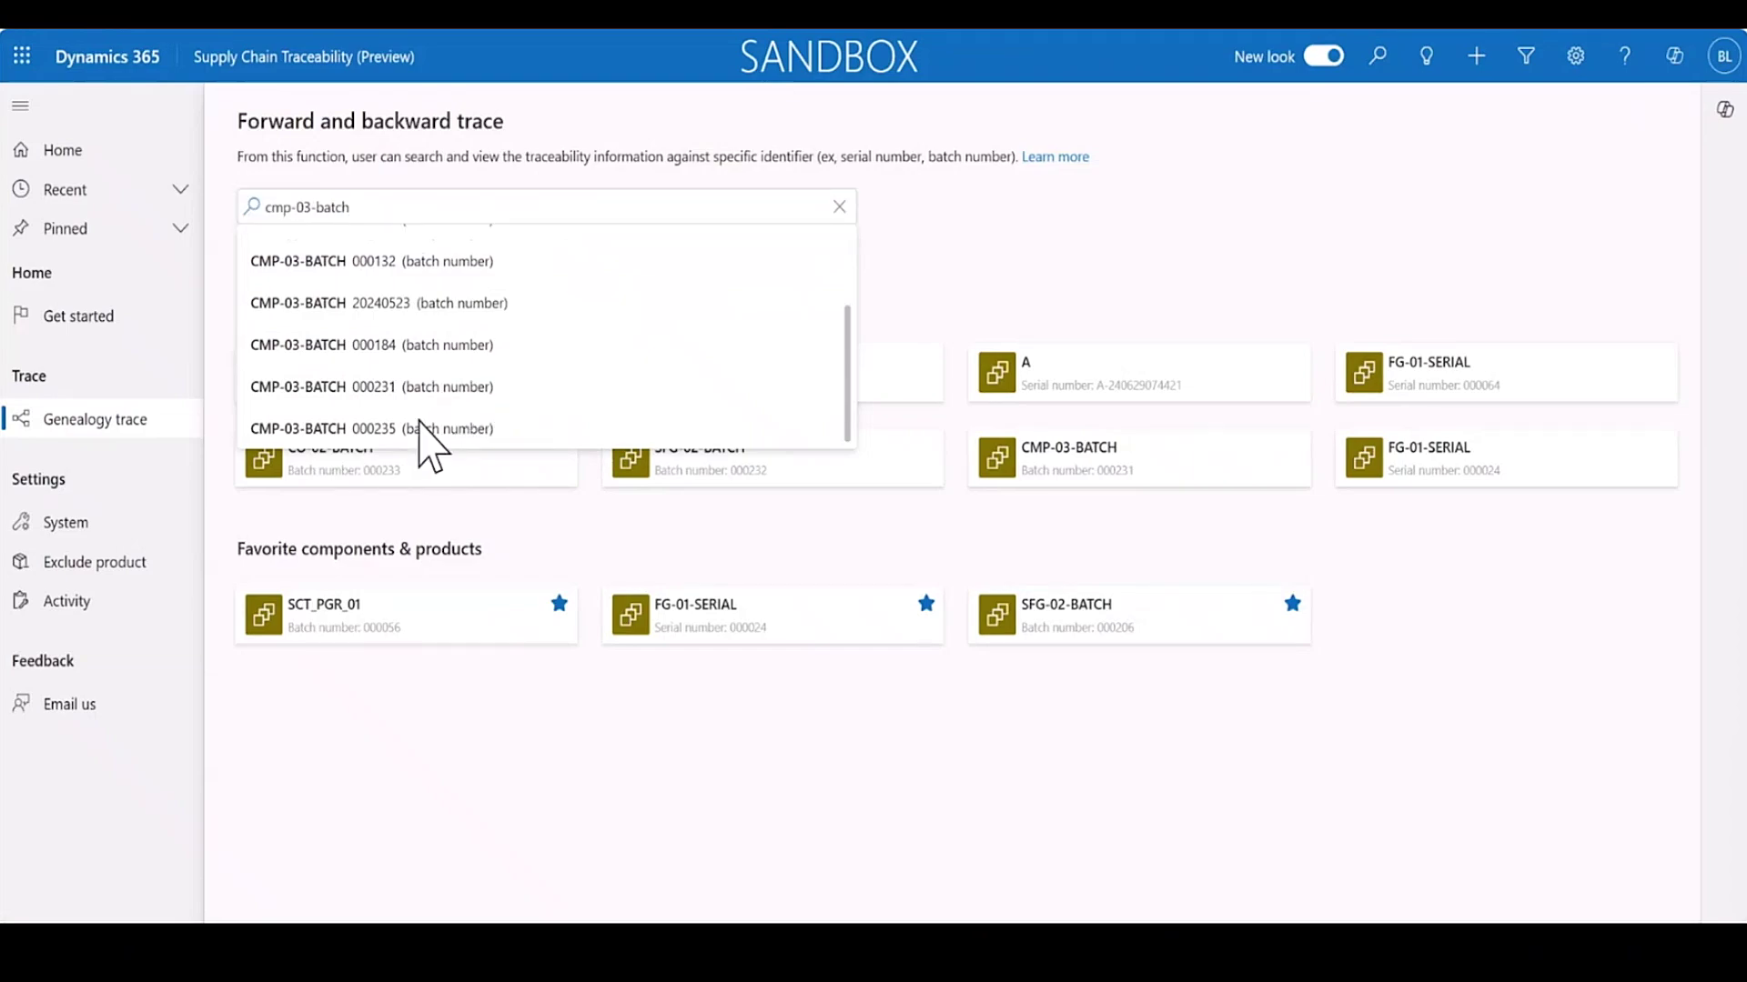

Slide 24
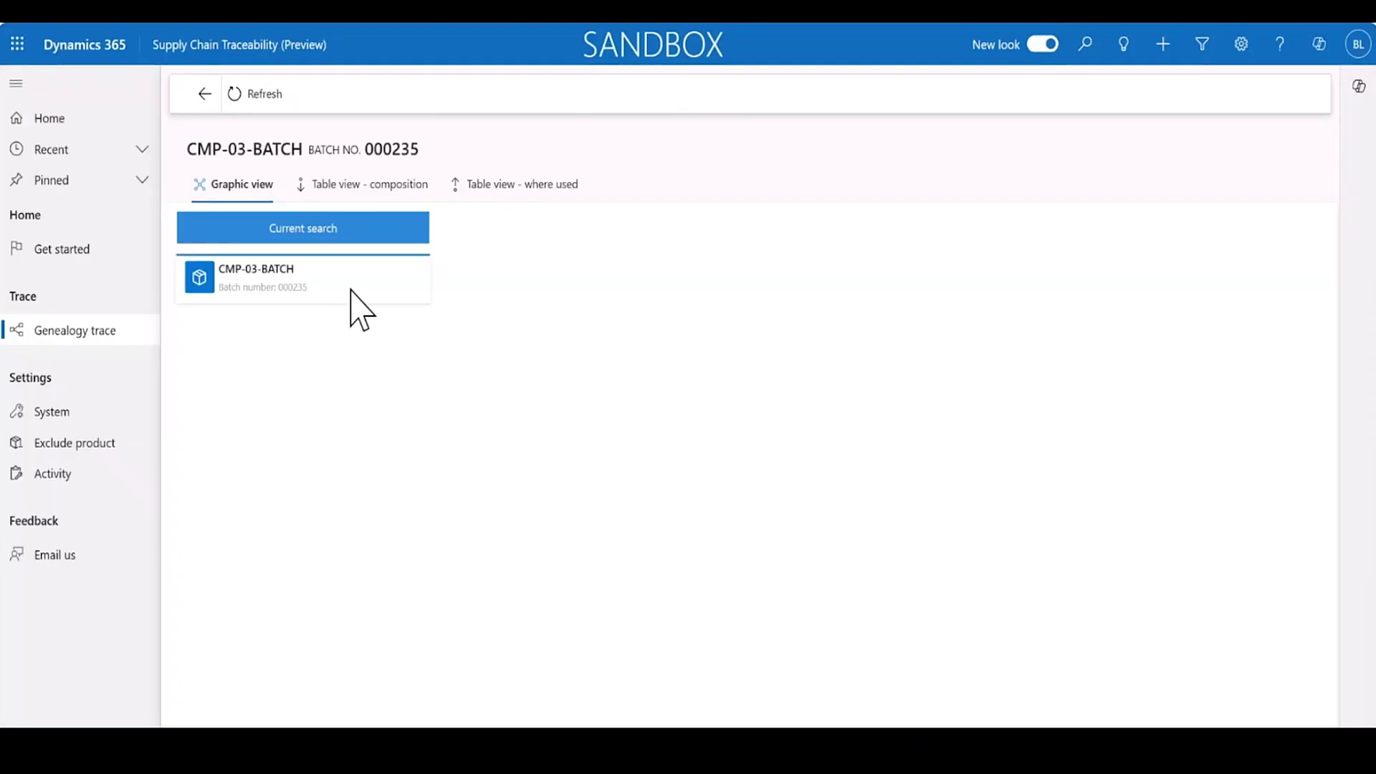

Slide 25
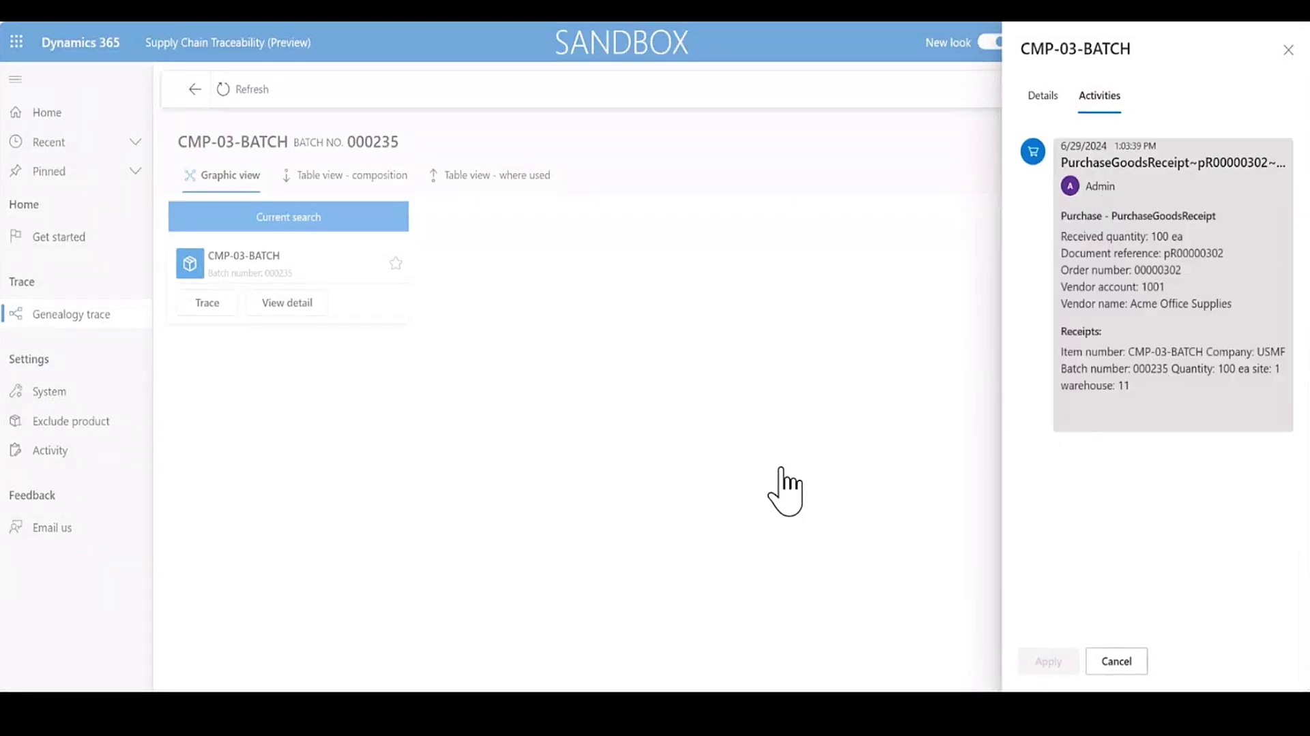

Slide 26
Production
Batch

Slide 27
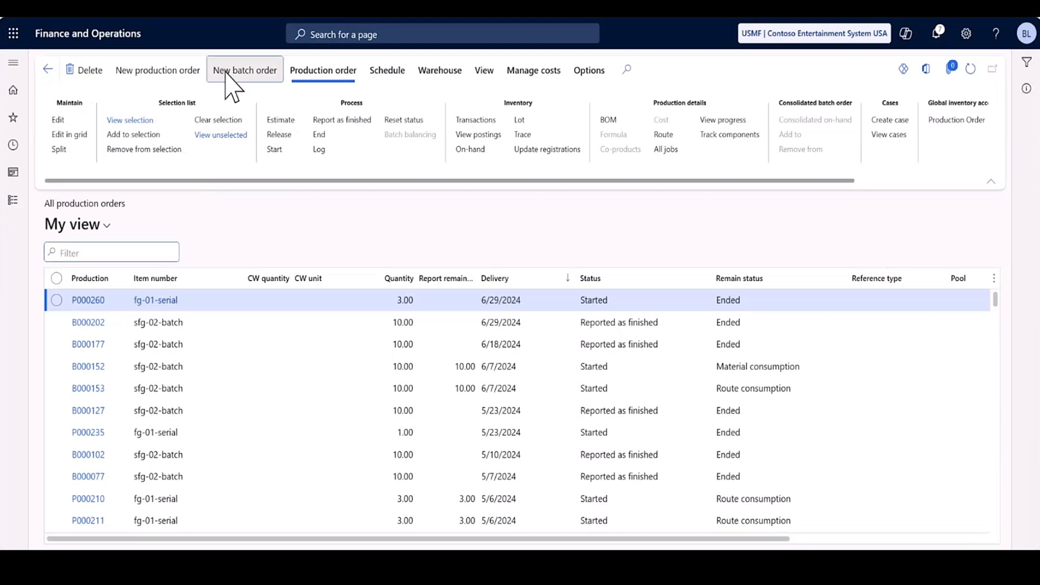

Slide 28
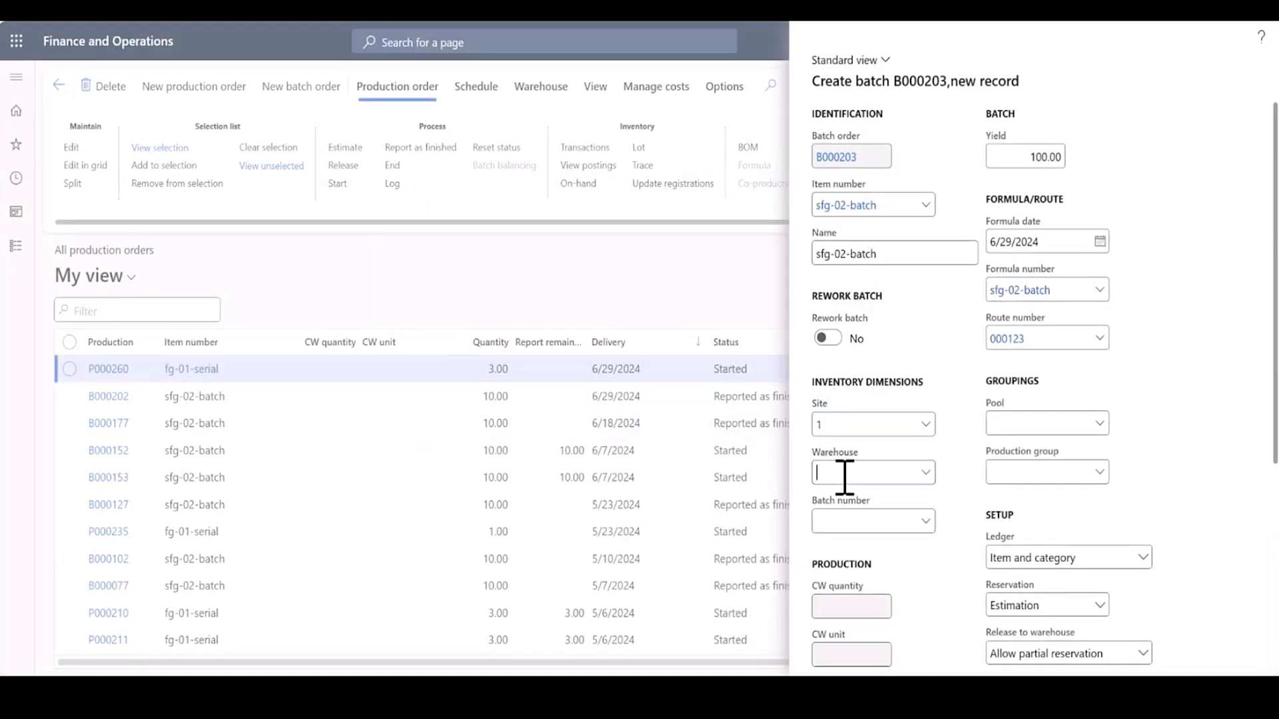

Slide 29
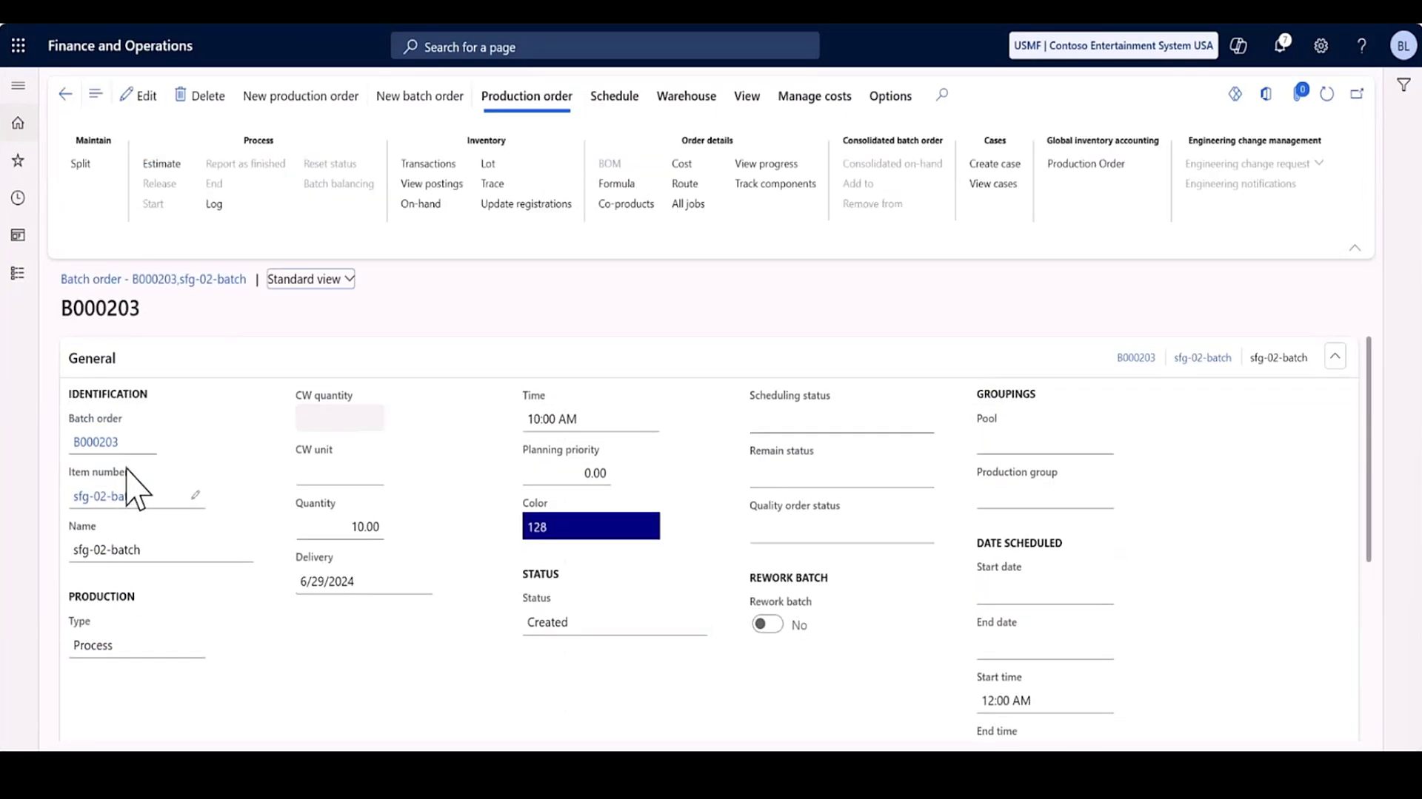

Slide 30
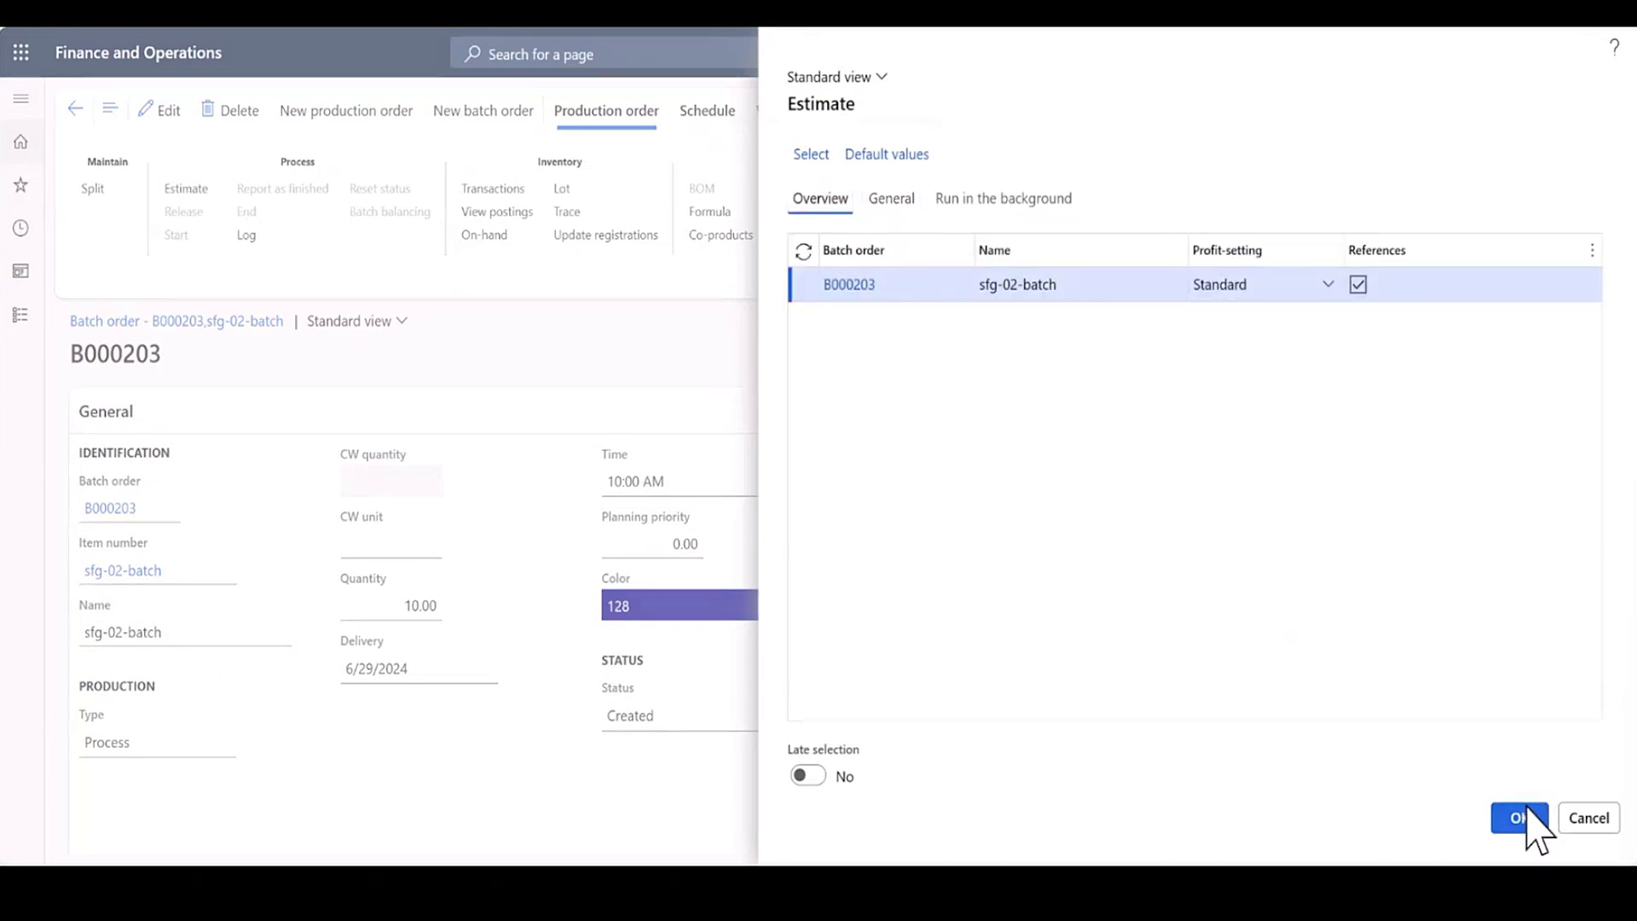

Slide 31
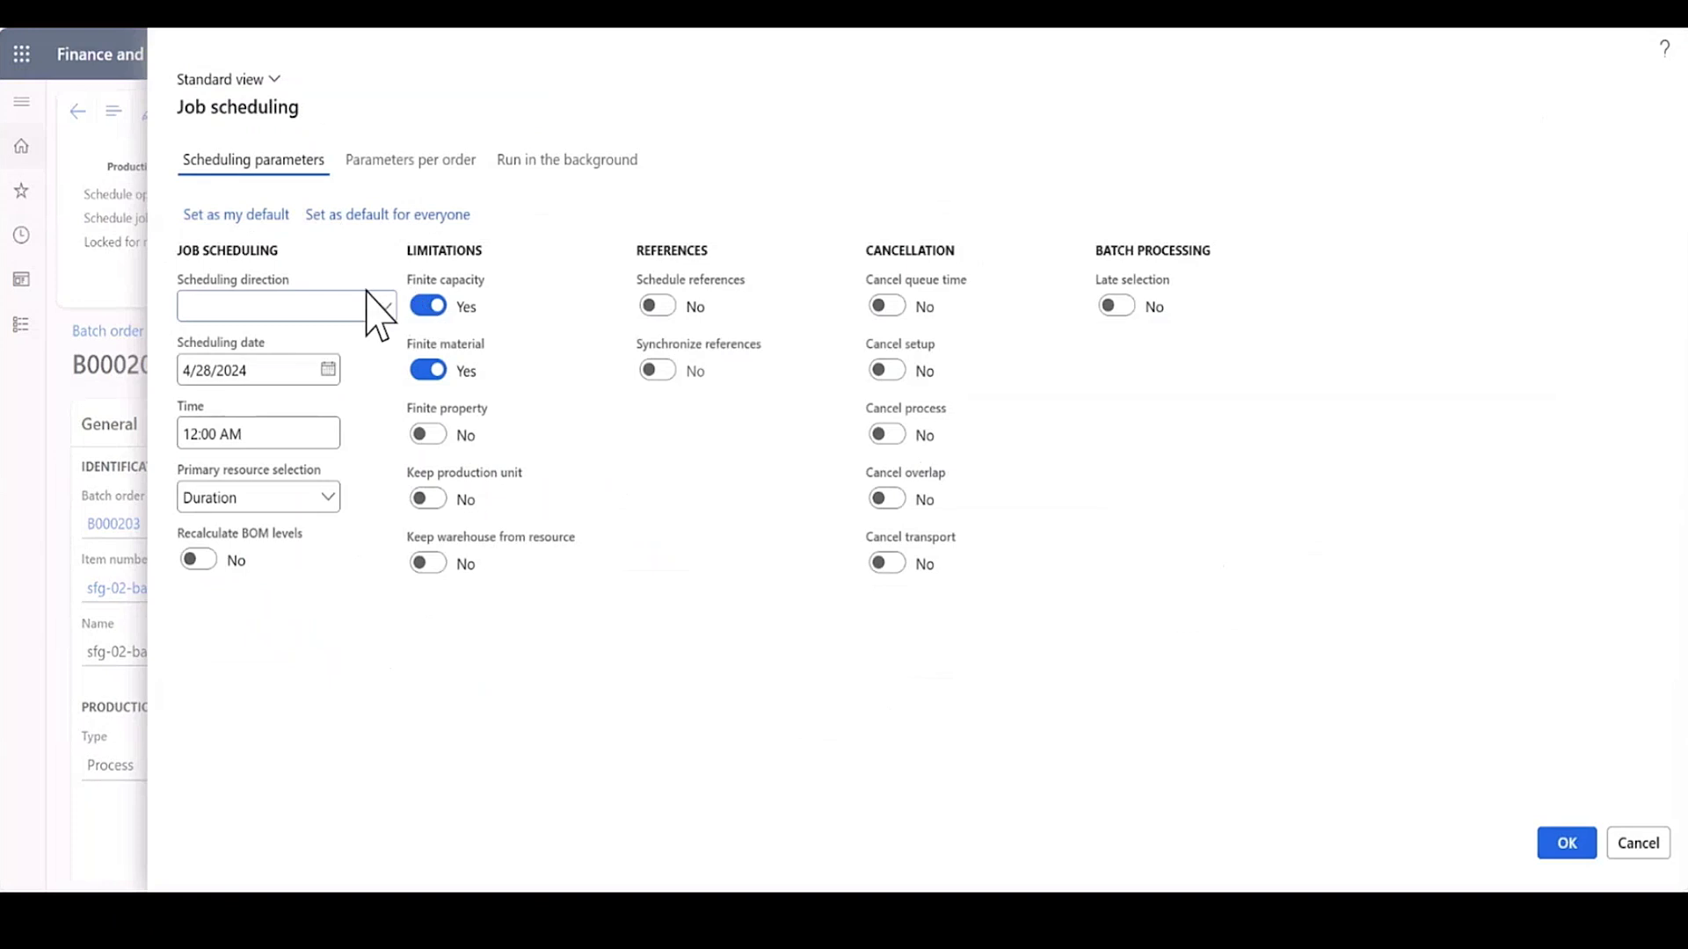

Slide 32
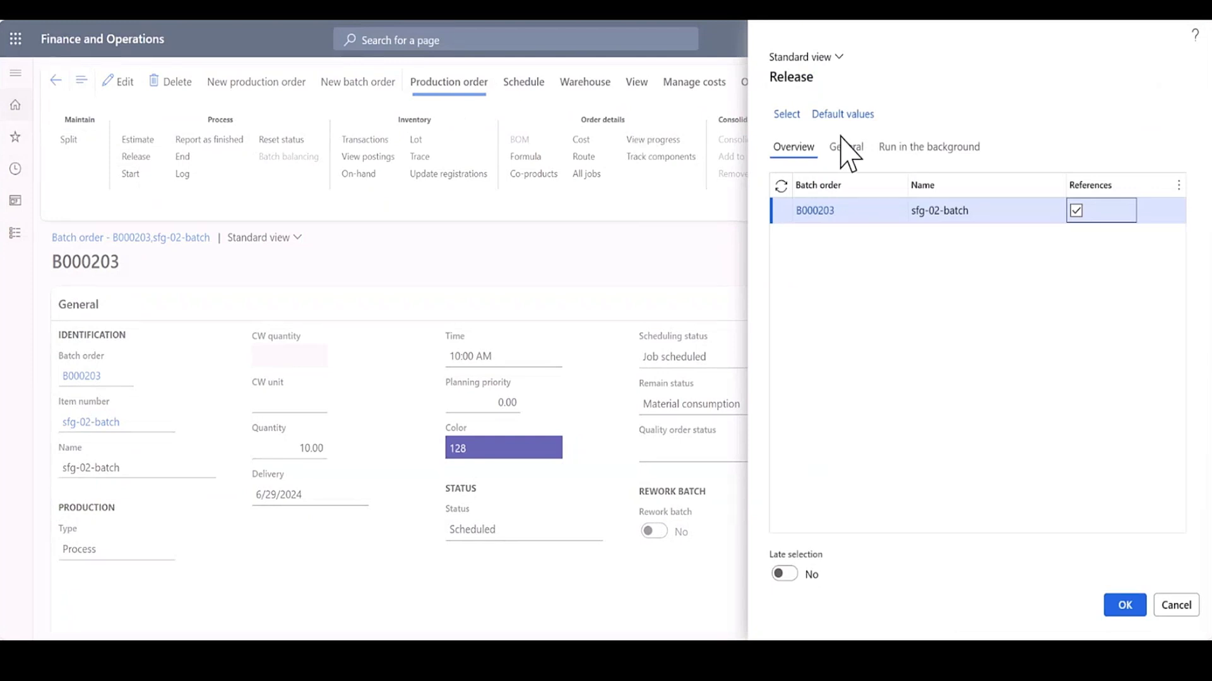

Slide 33
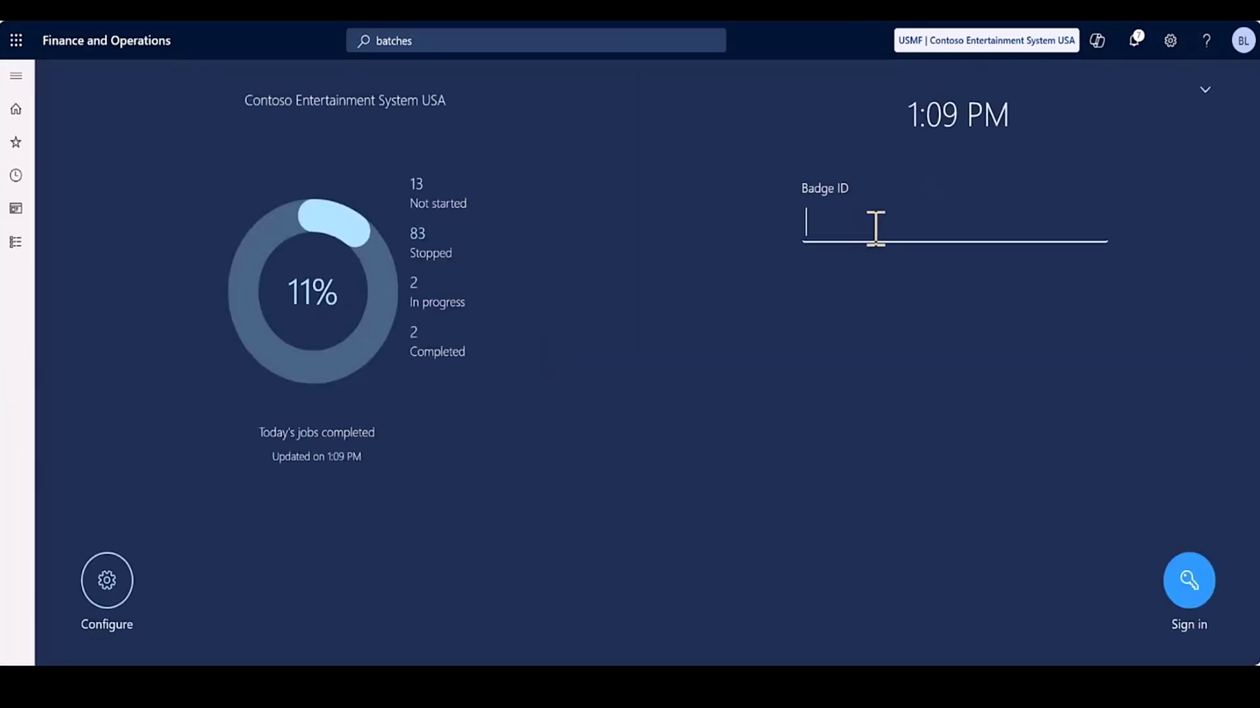

Slide 34
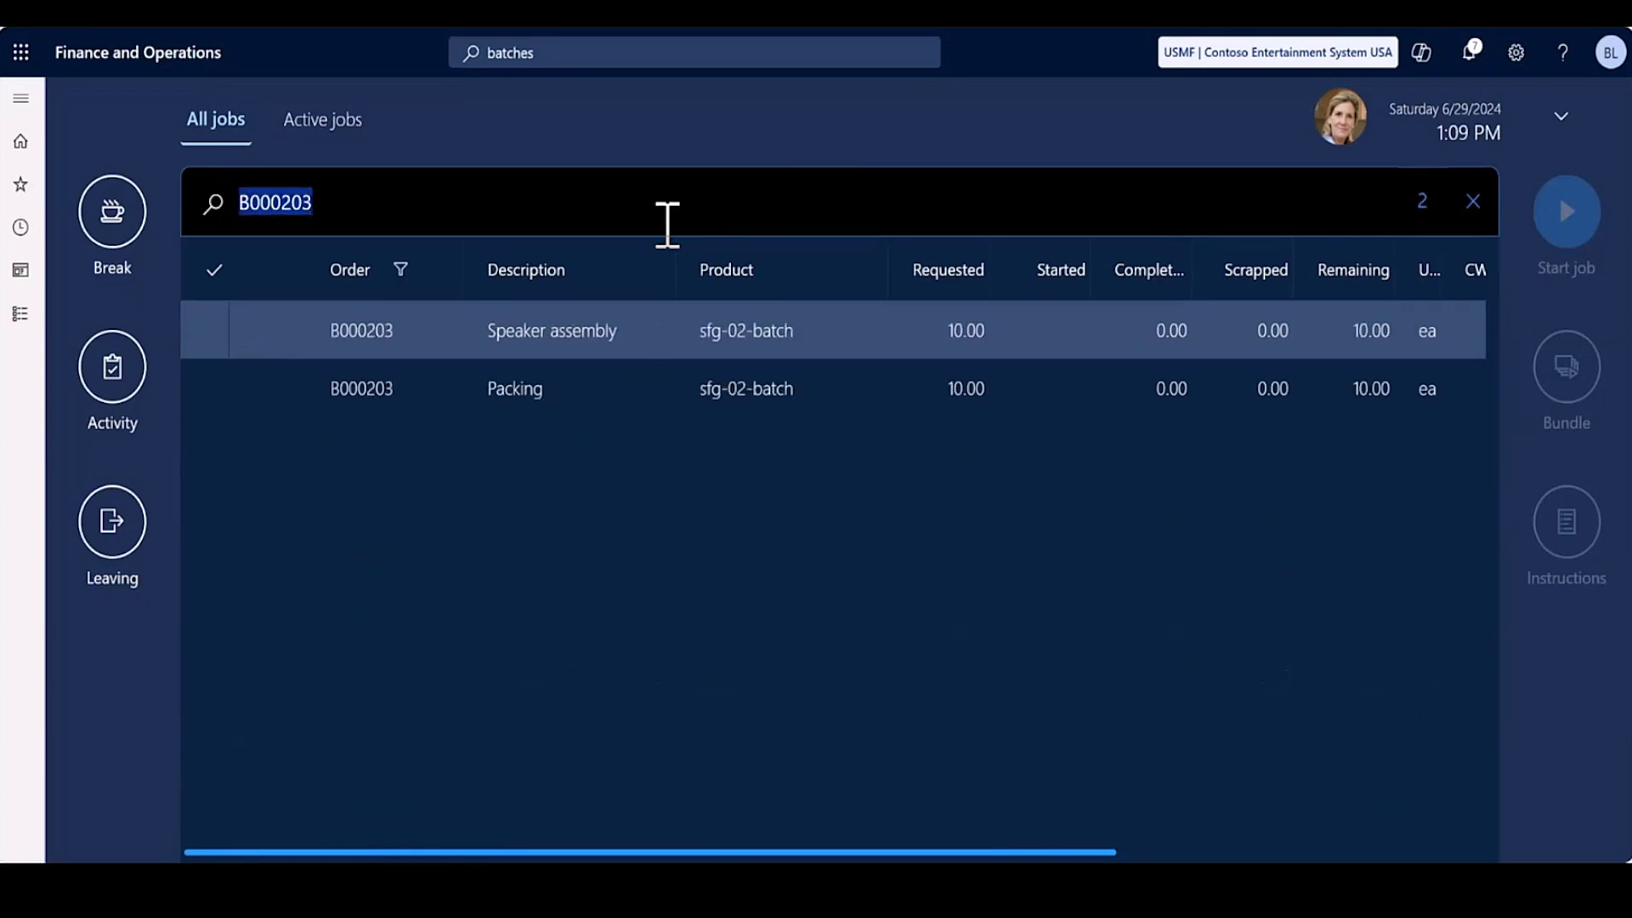

Slide 35
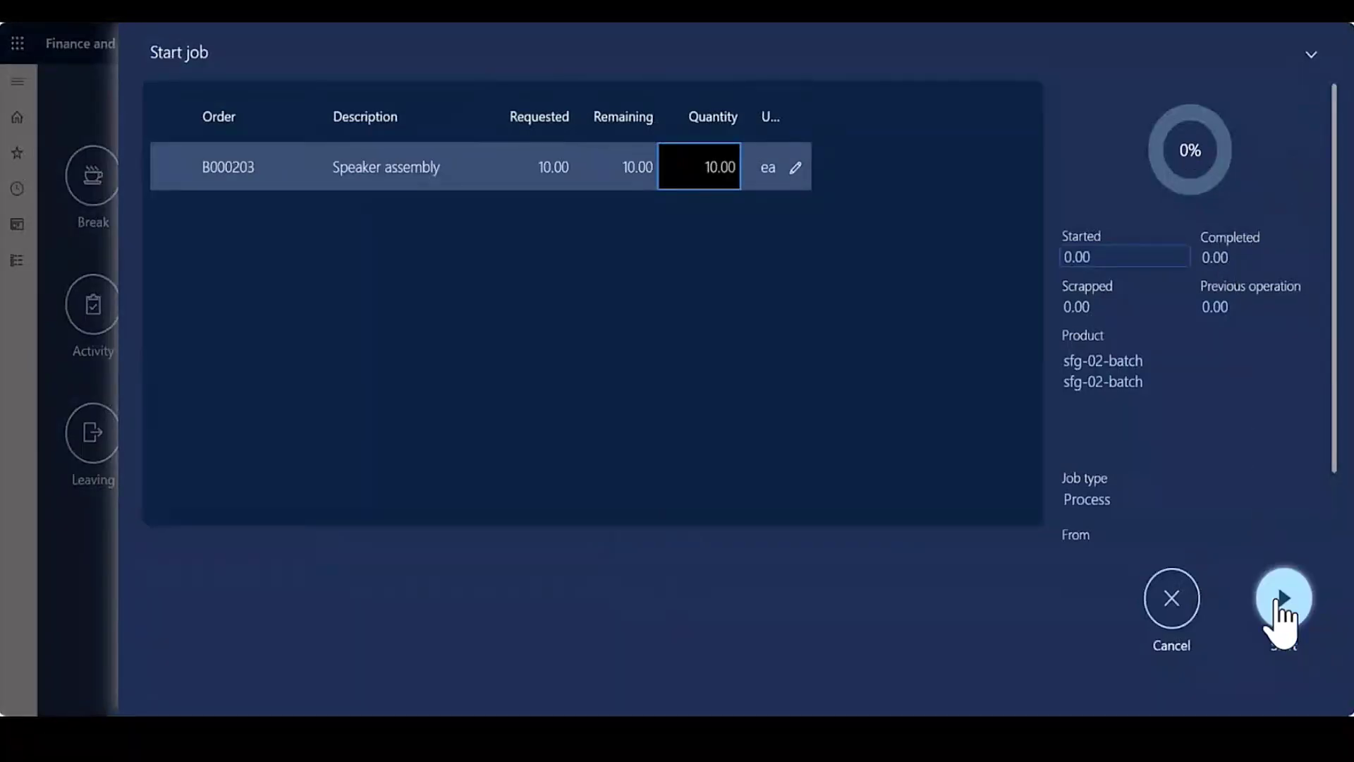

Slide 36
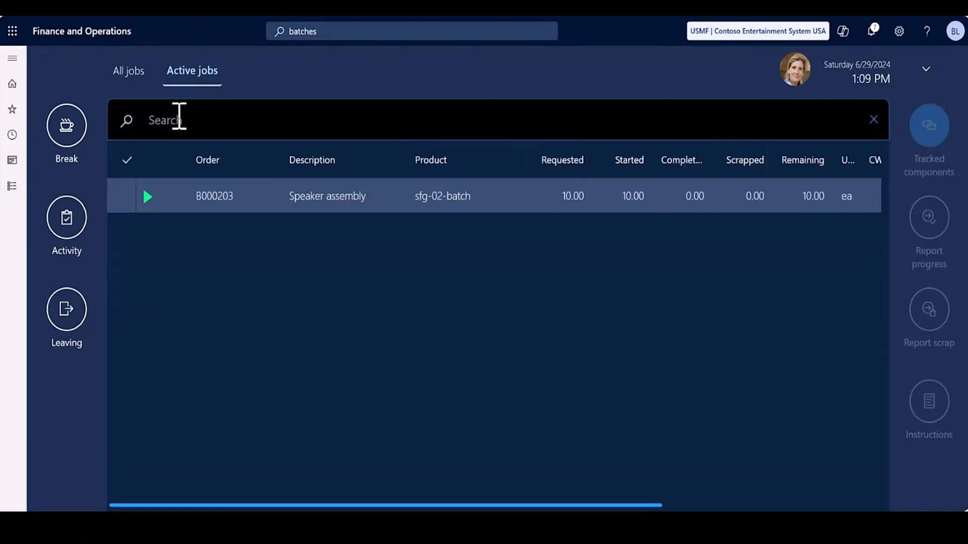

Slide 37
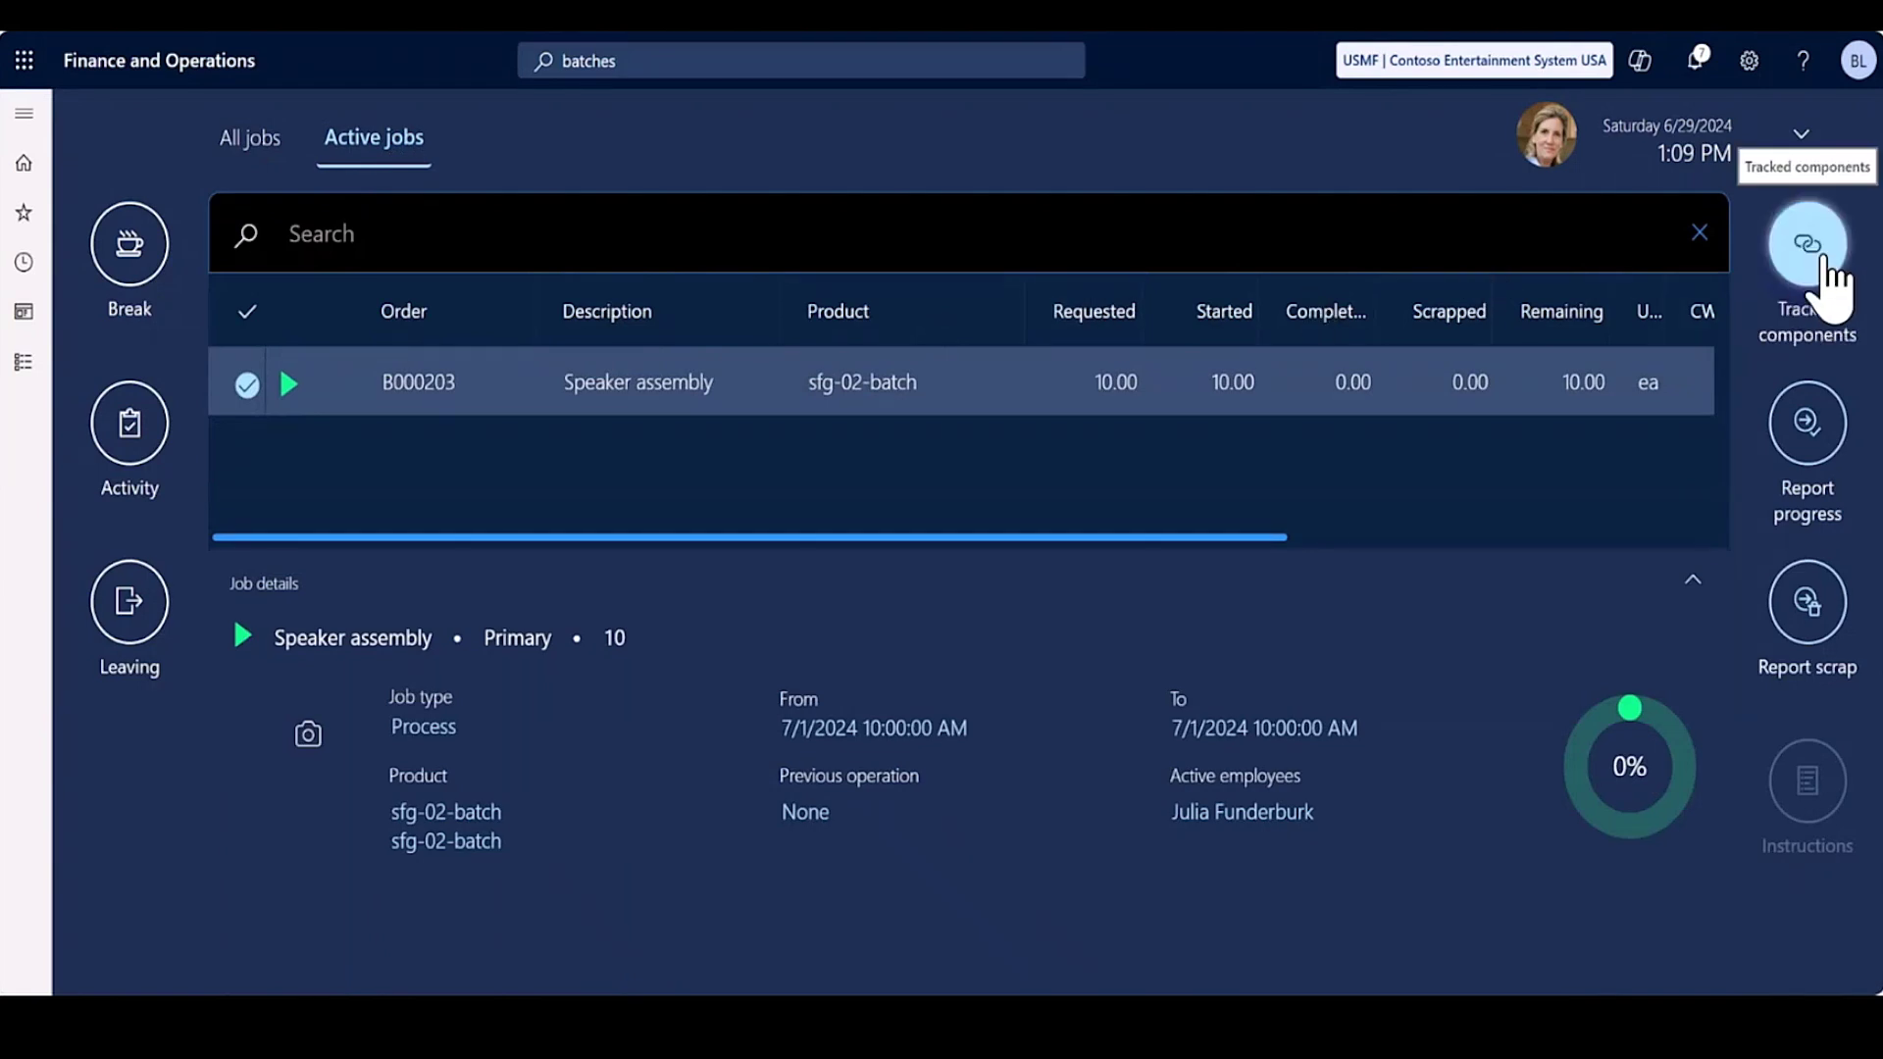

Slide 38
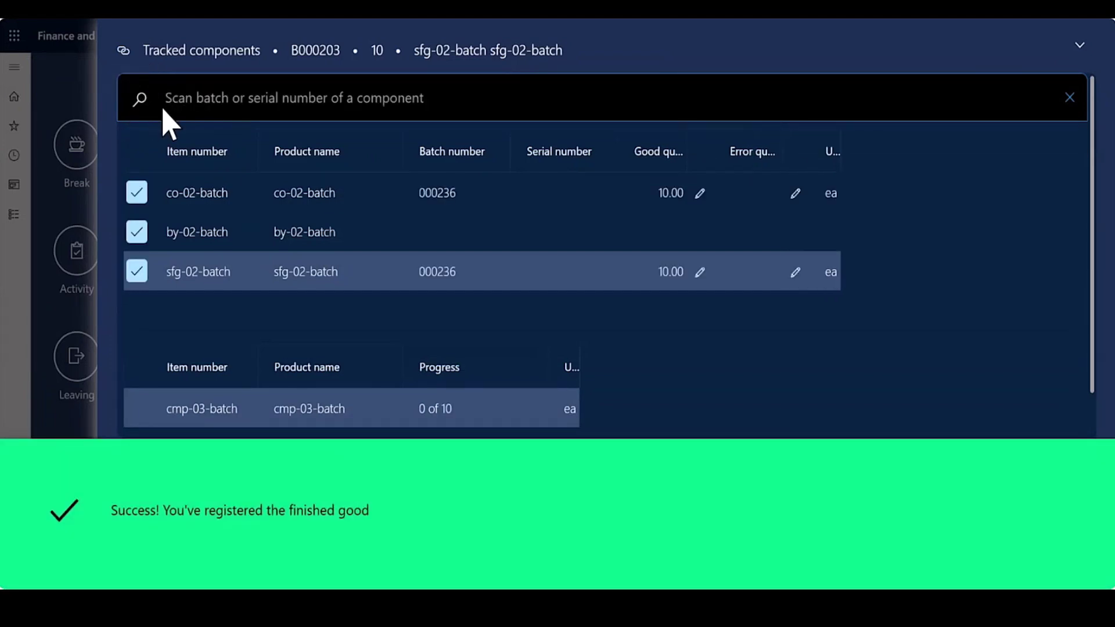

Slide 39
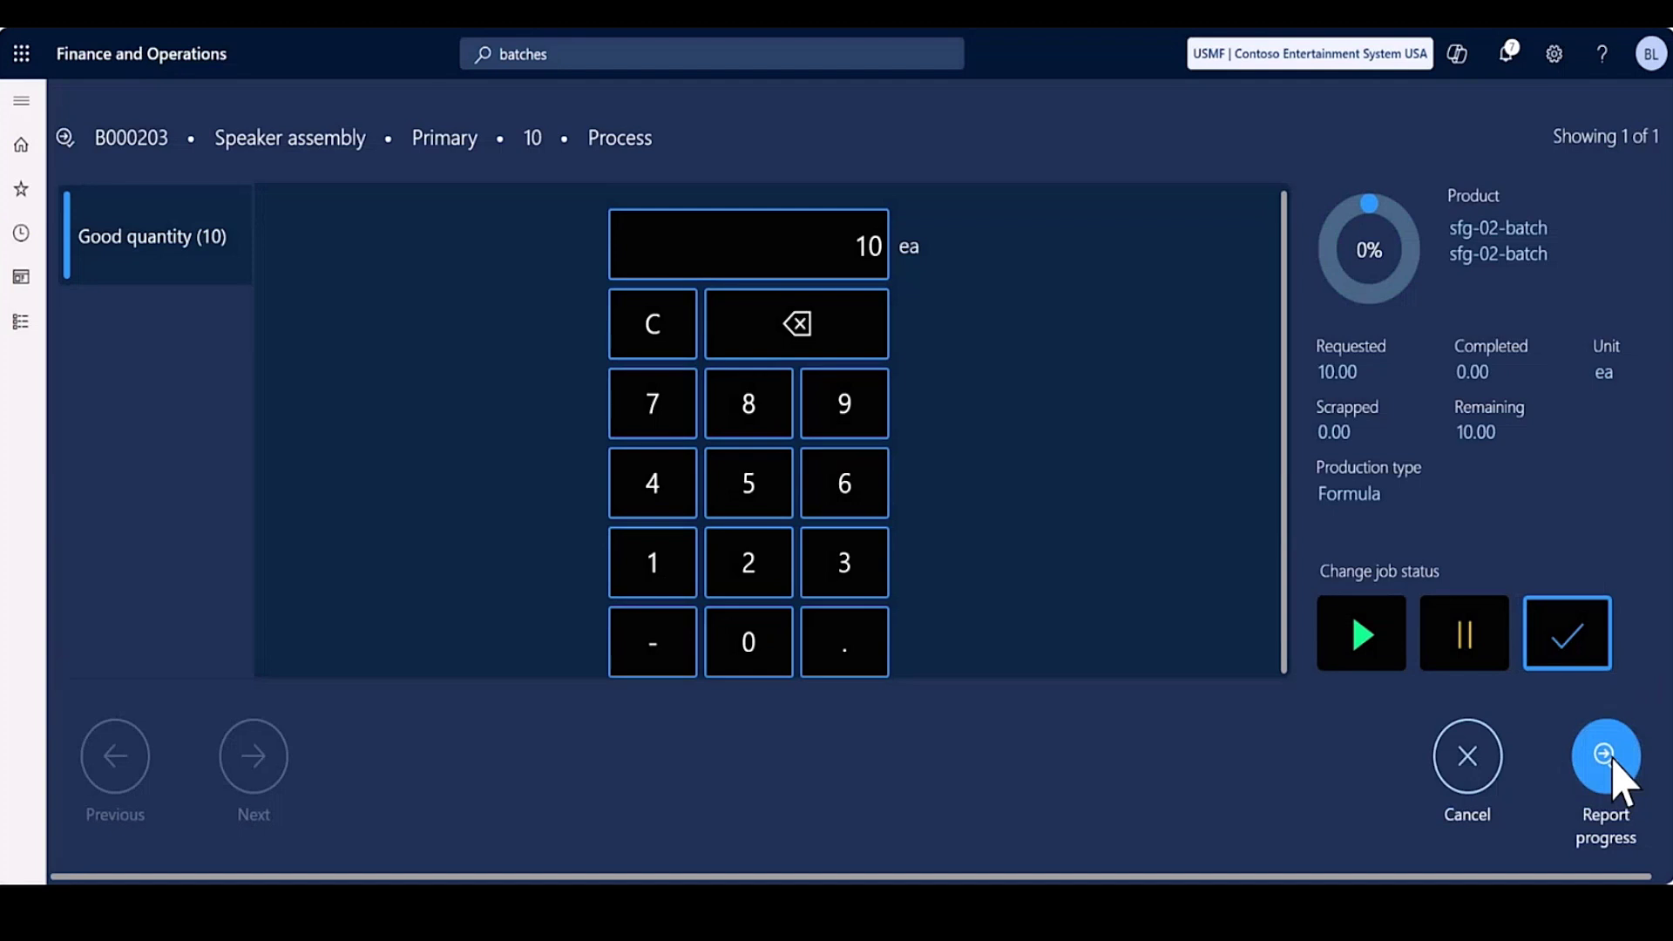

Slide 40
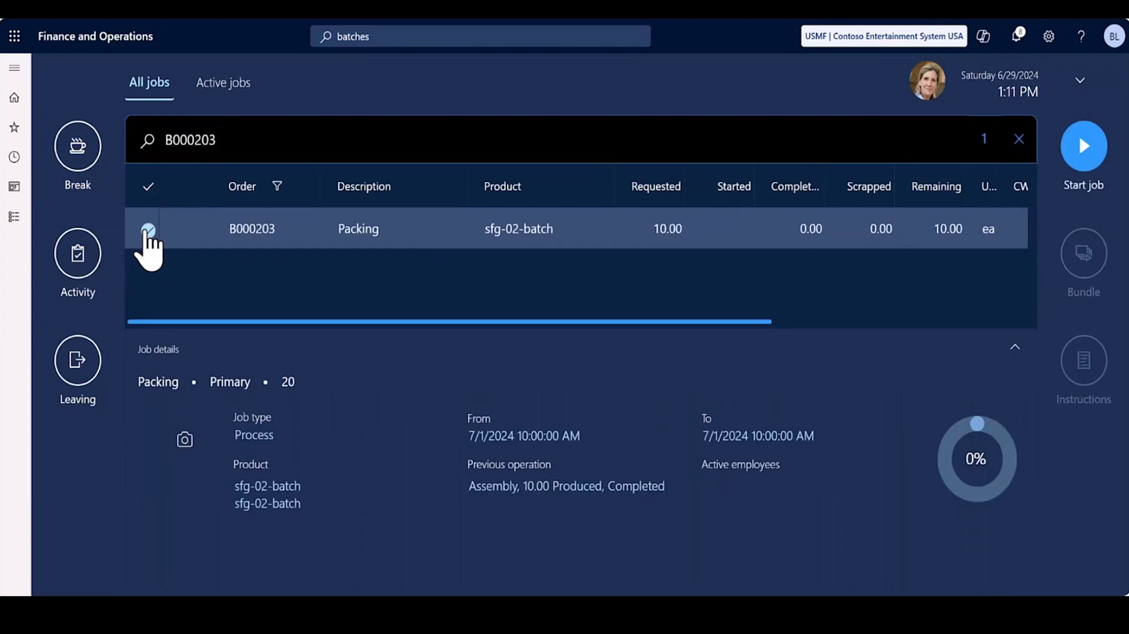

Slide 41
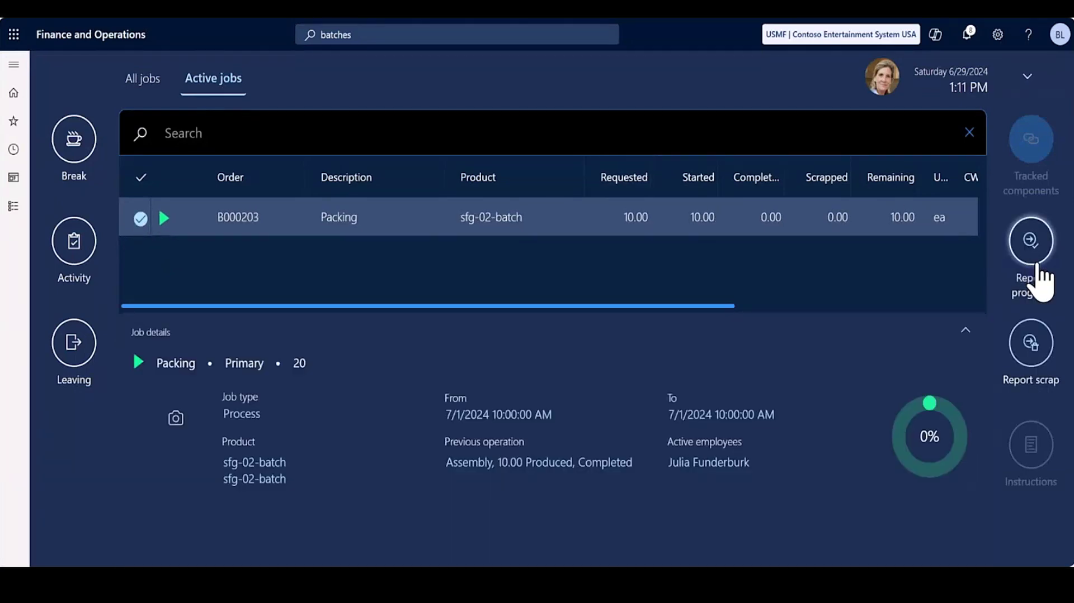

Slide 42
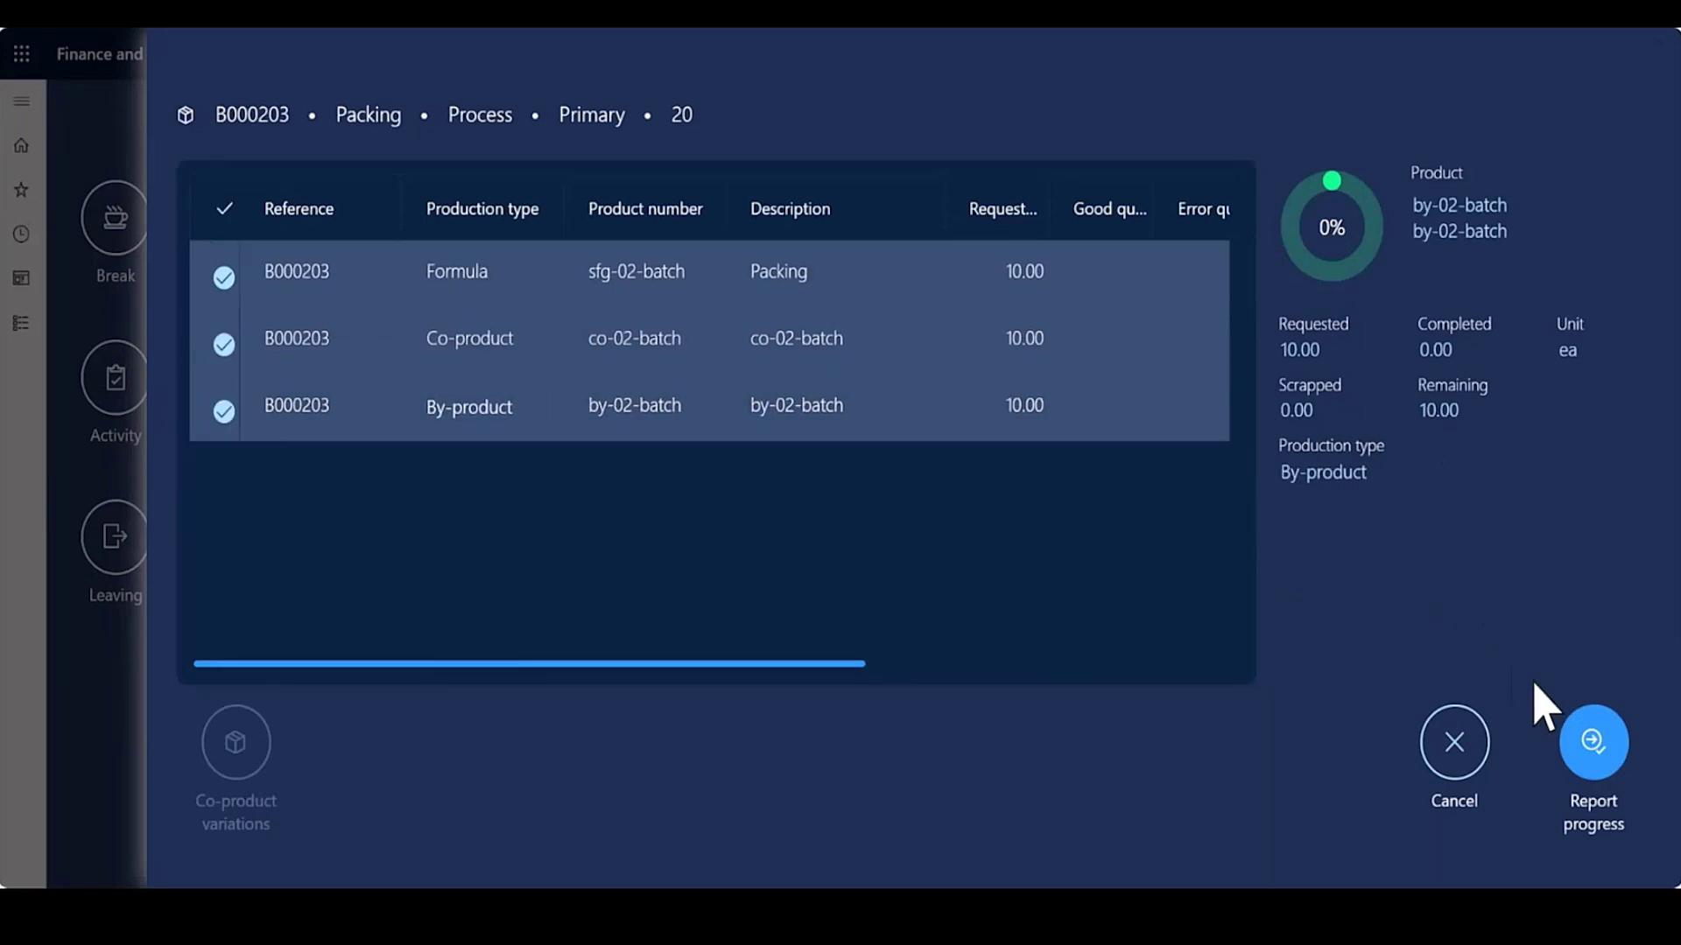

Slide 43
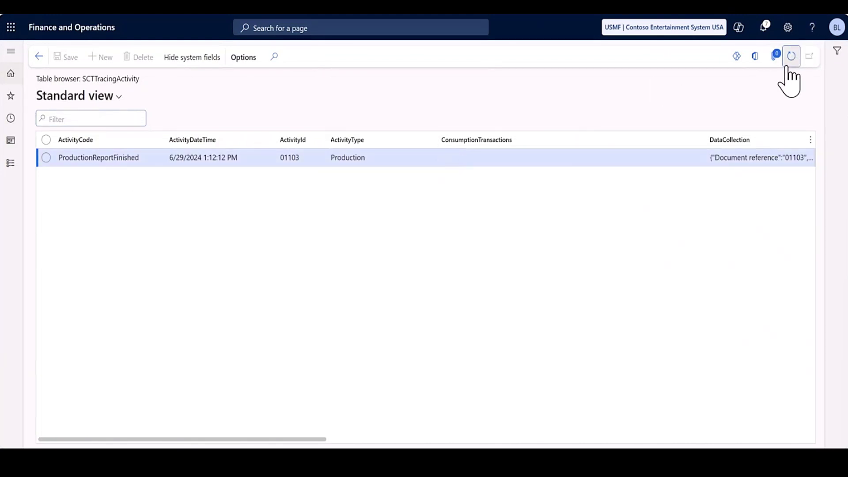

Slide 44
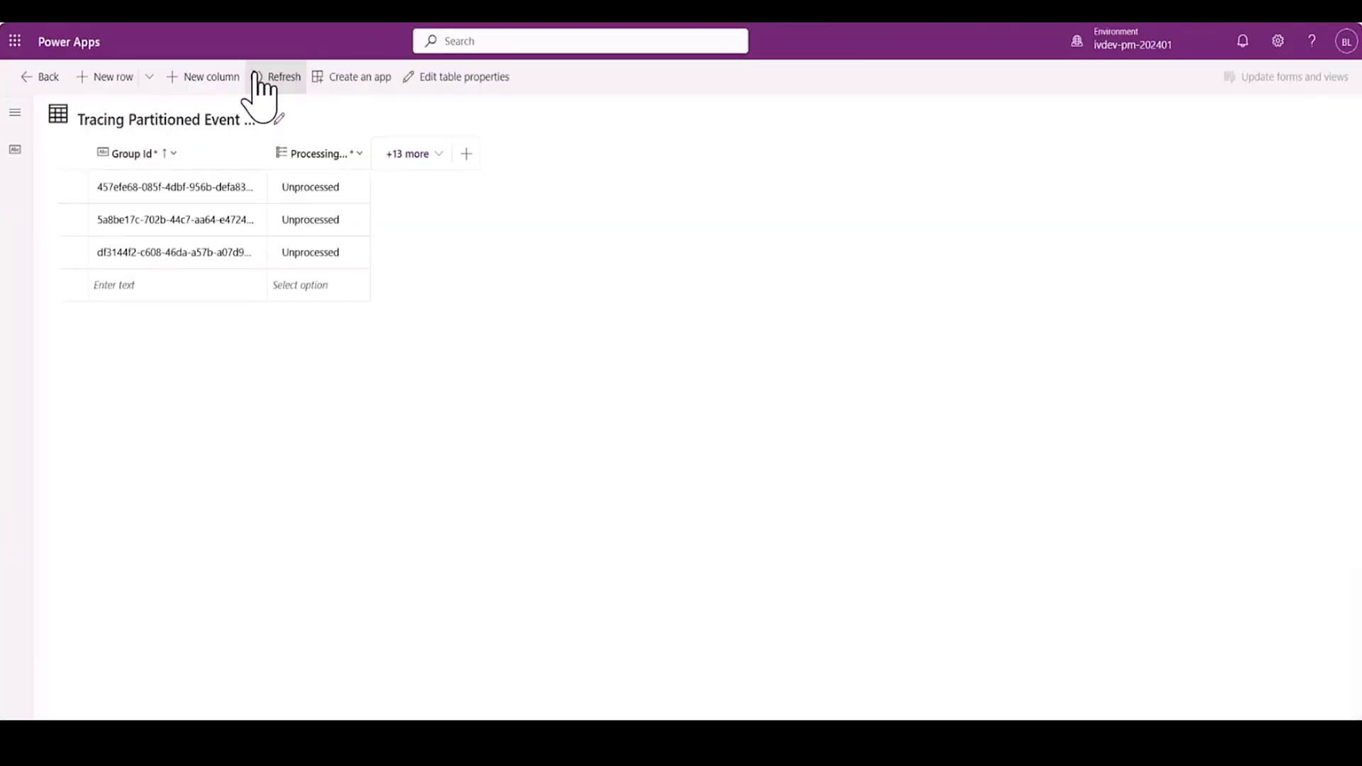

Slide 45
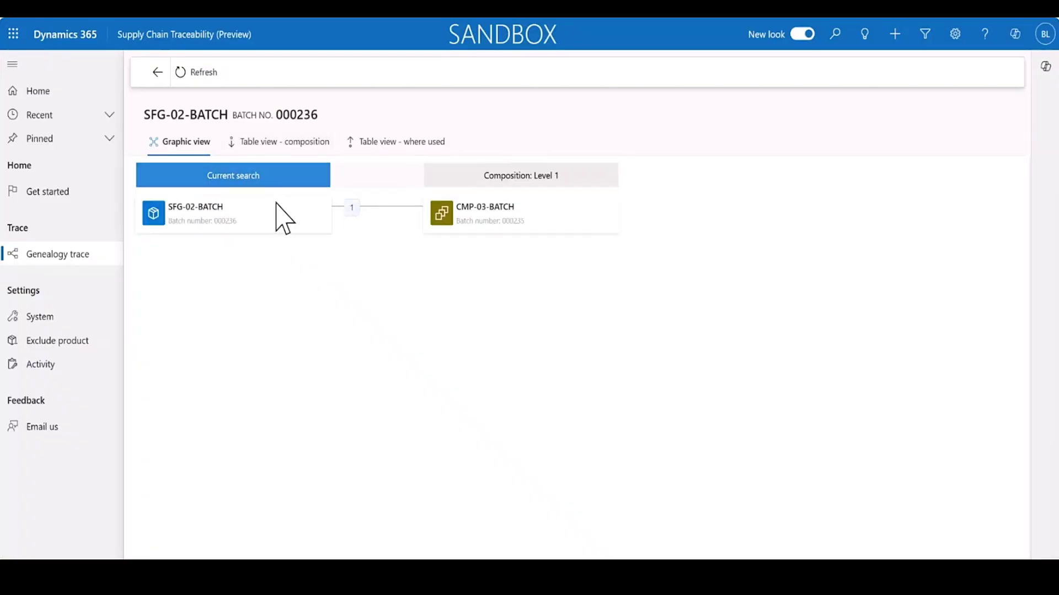

Slide 46
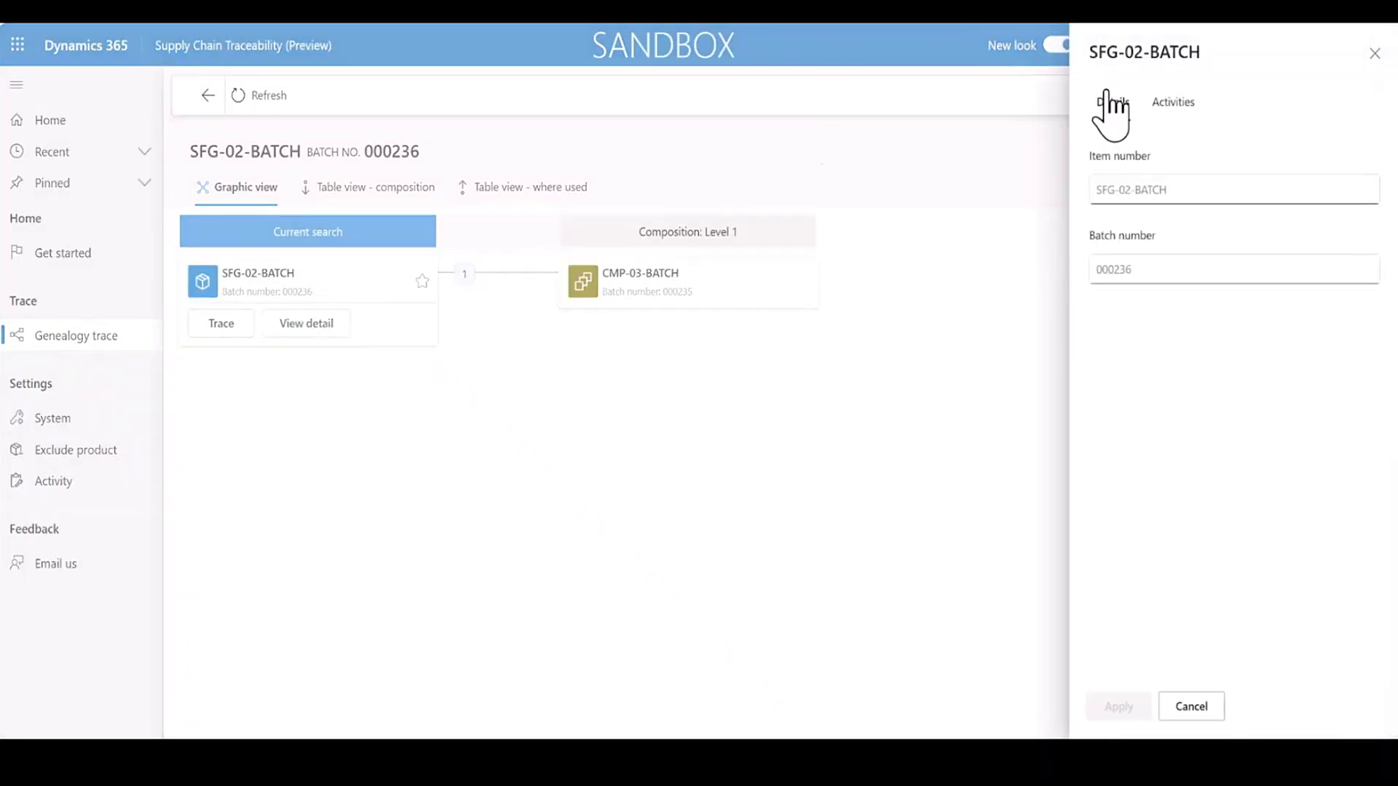

Slide 47
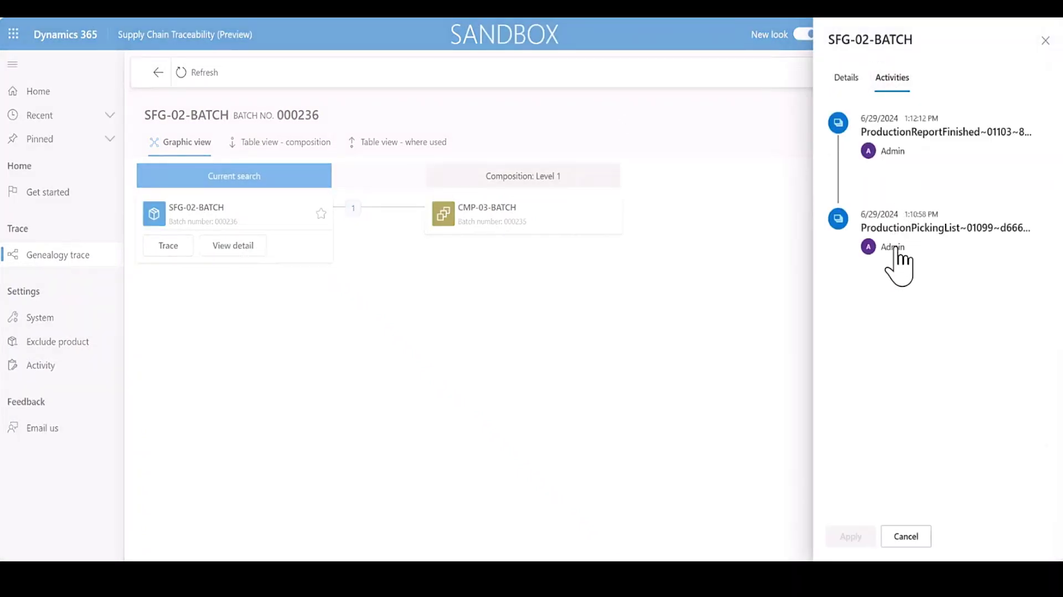

Slide 48
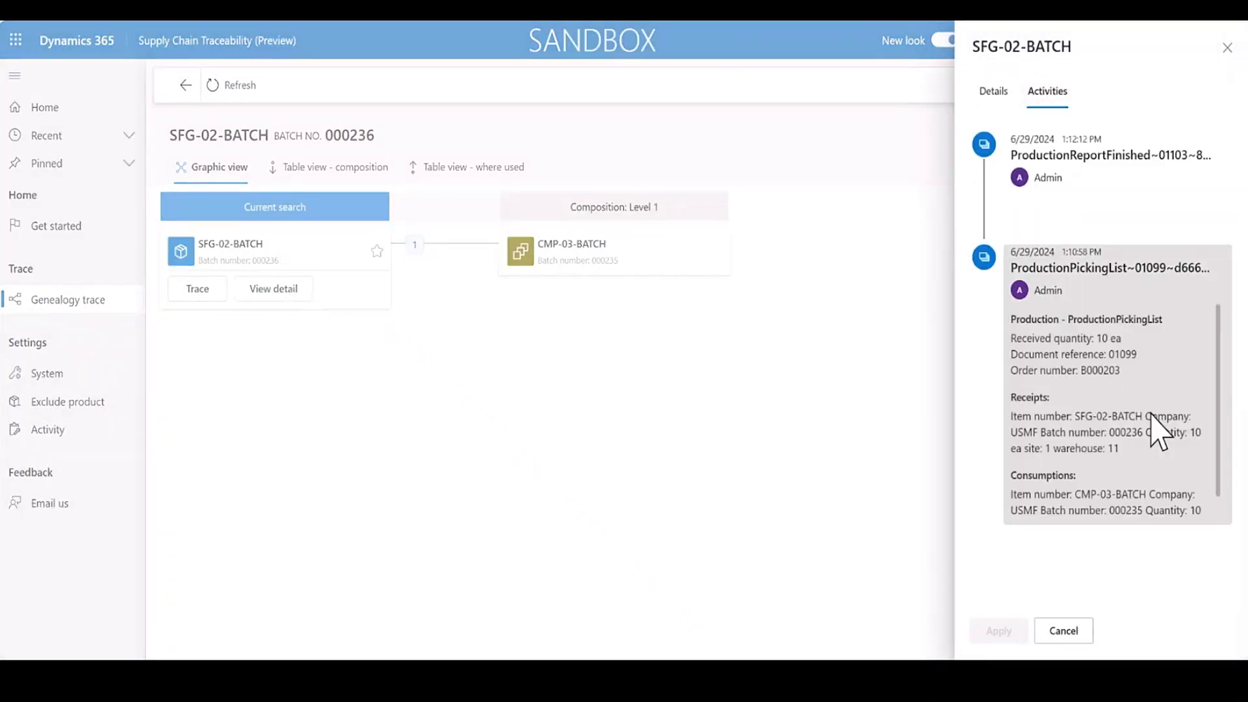

Slide 49
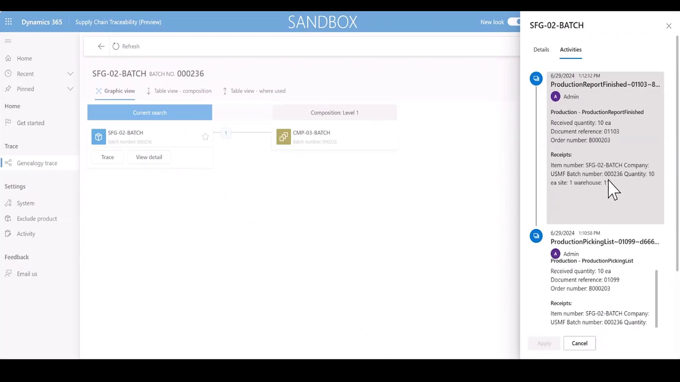

Slide 50
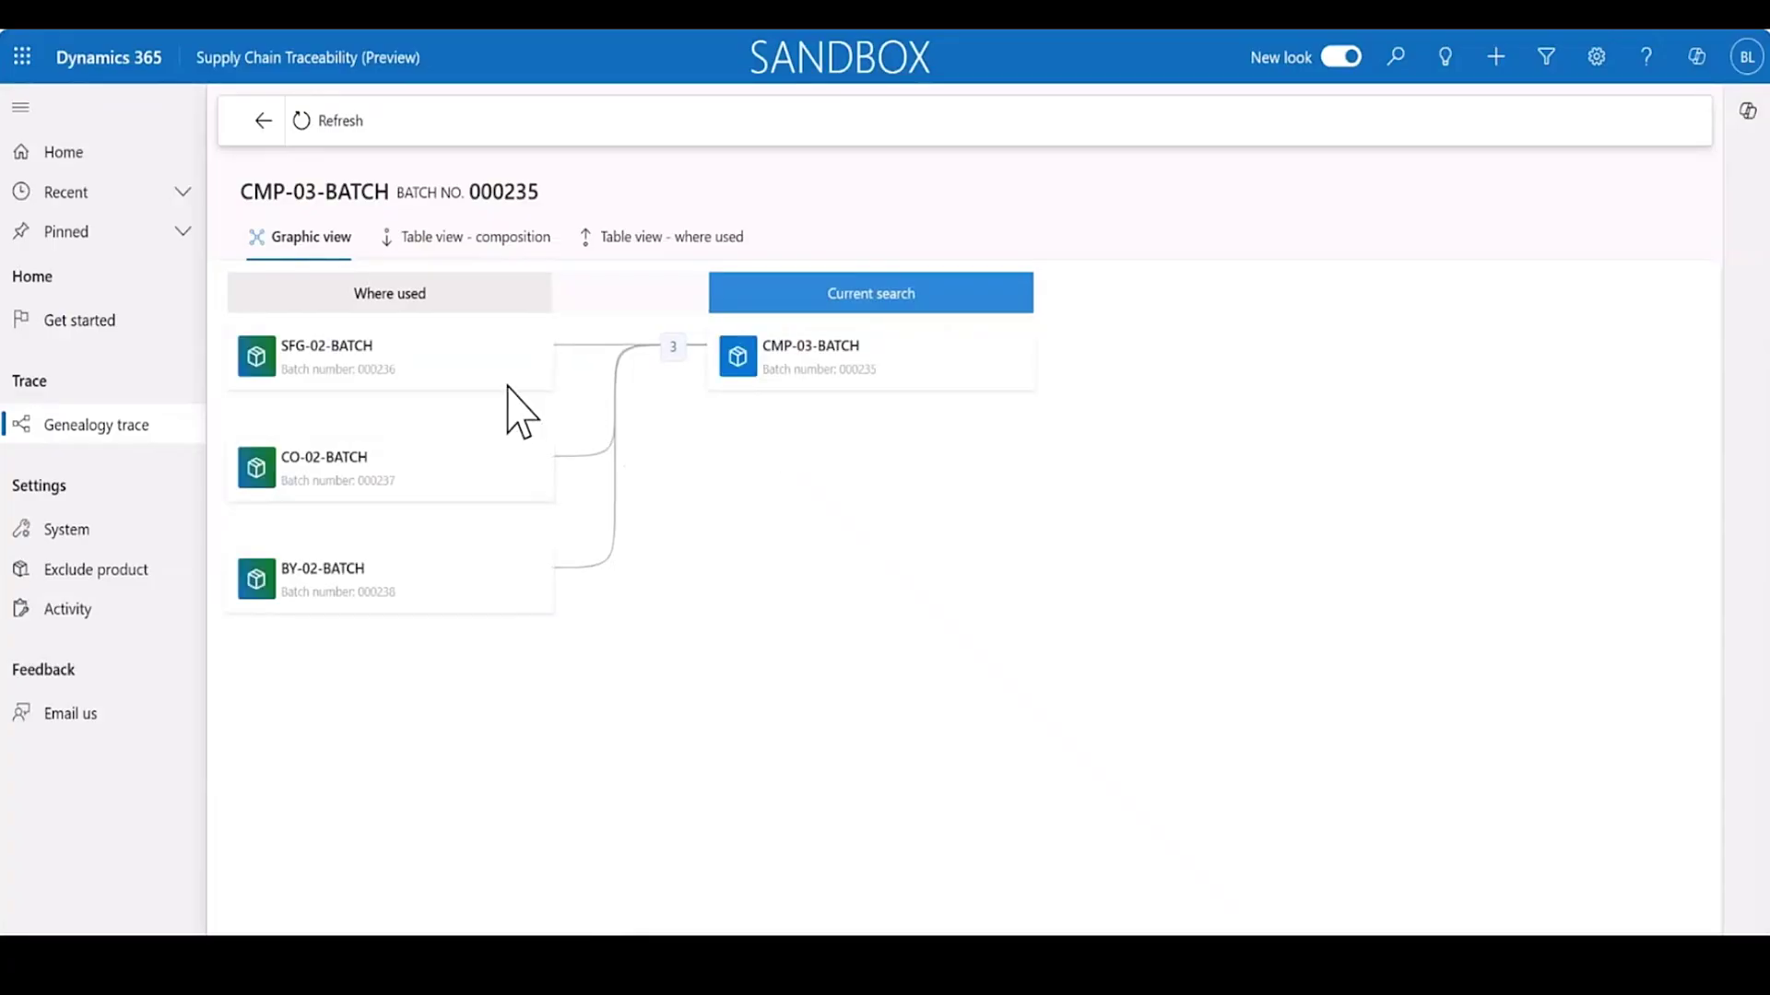

Slide 51
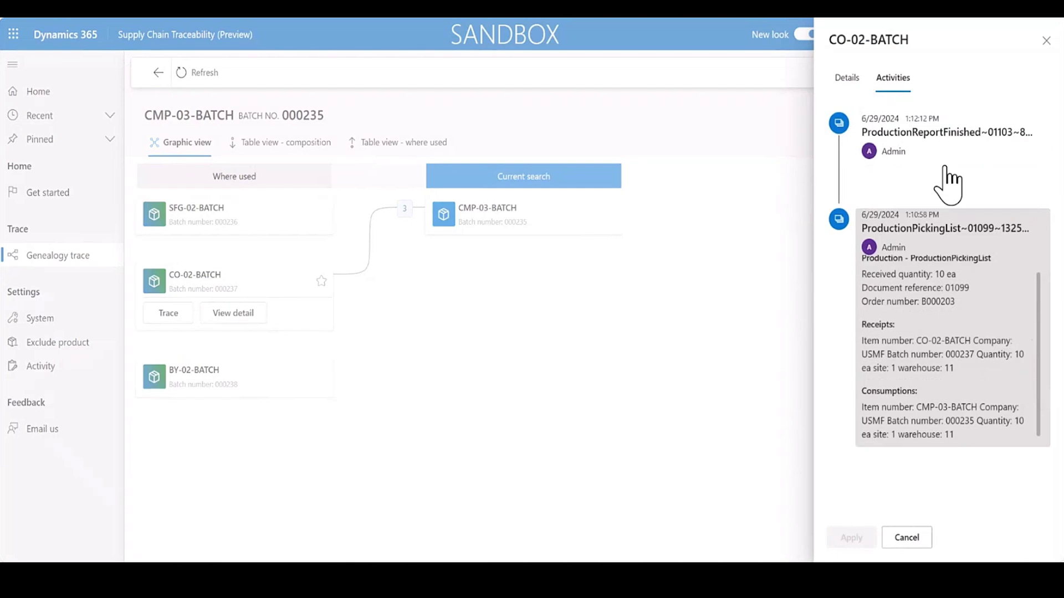

Slide 52
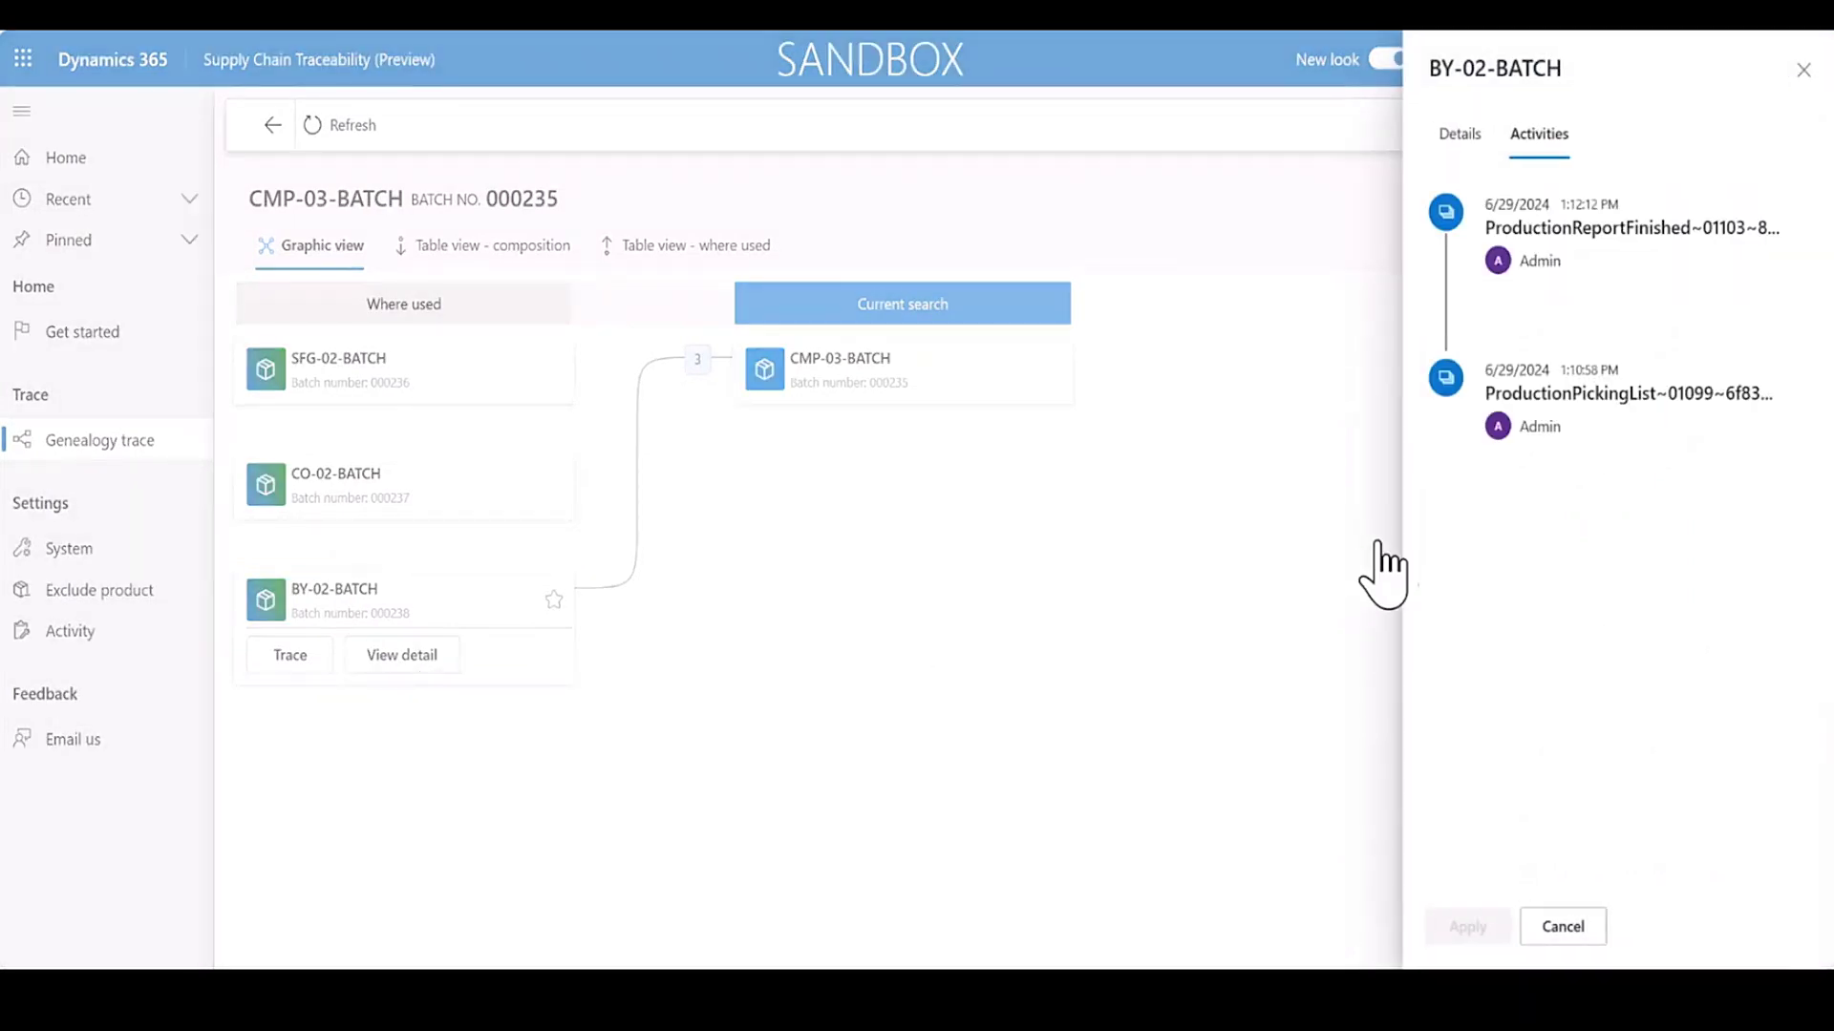

Slide 53
Purchase Order
Serial

Slide 54
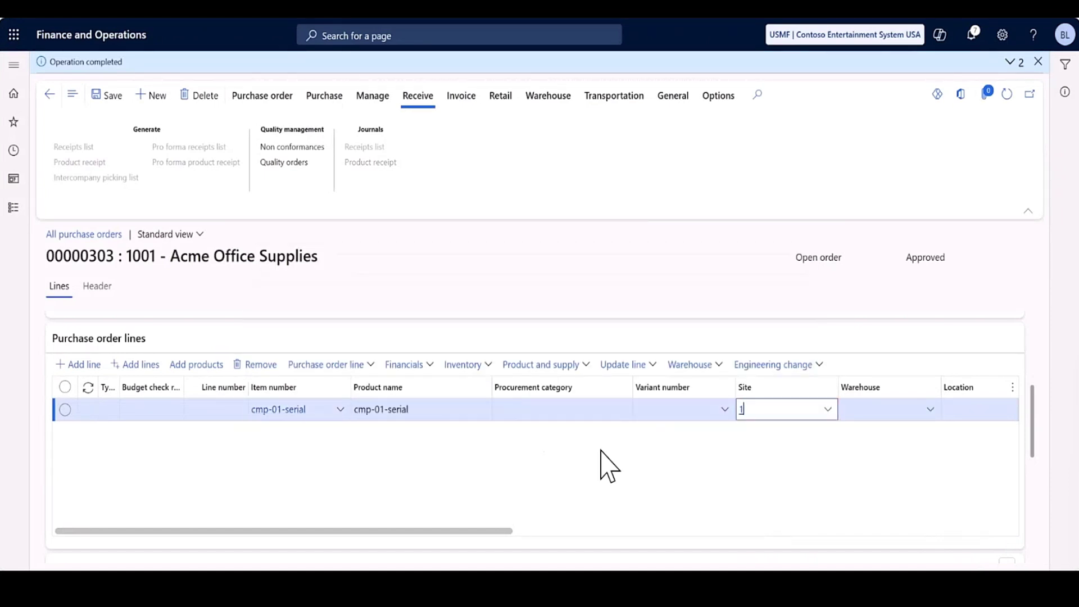

Slide 55
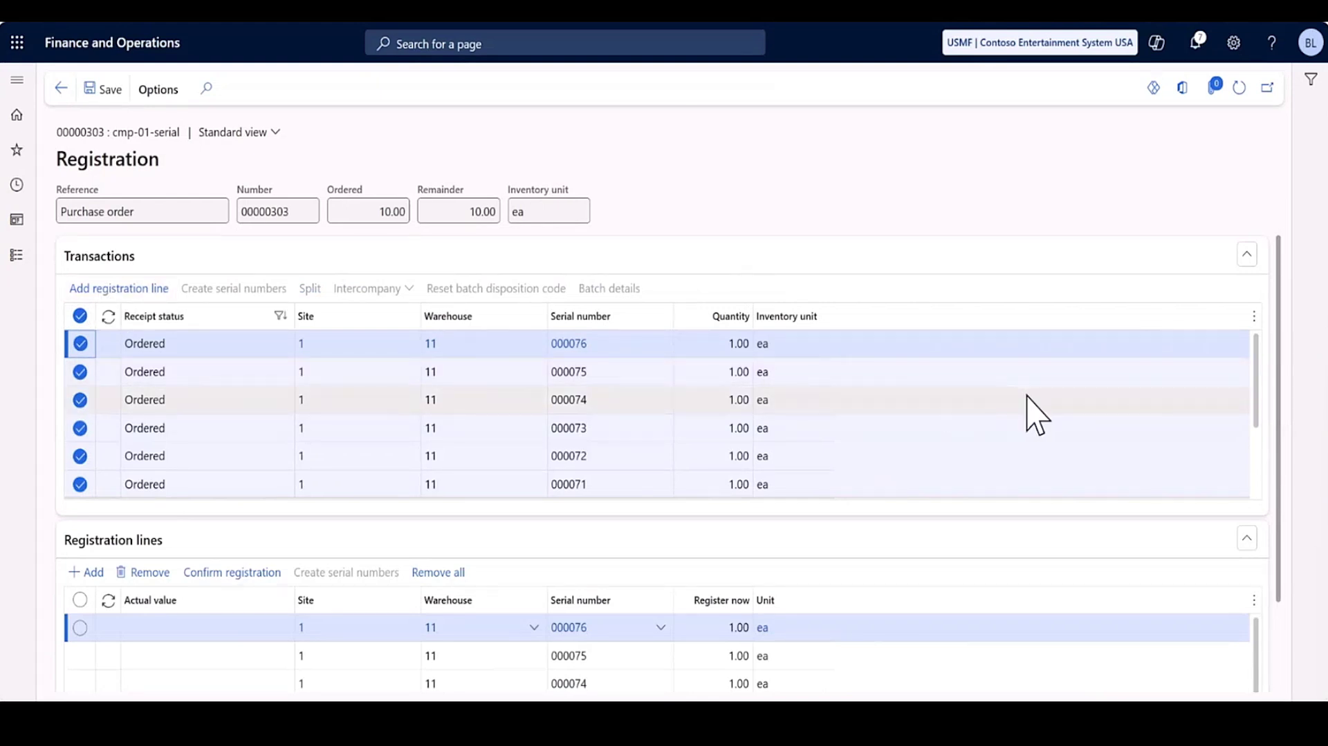

Slide 56
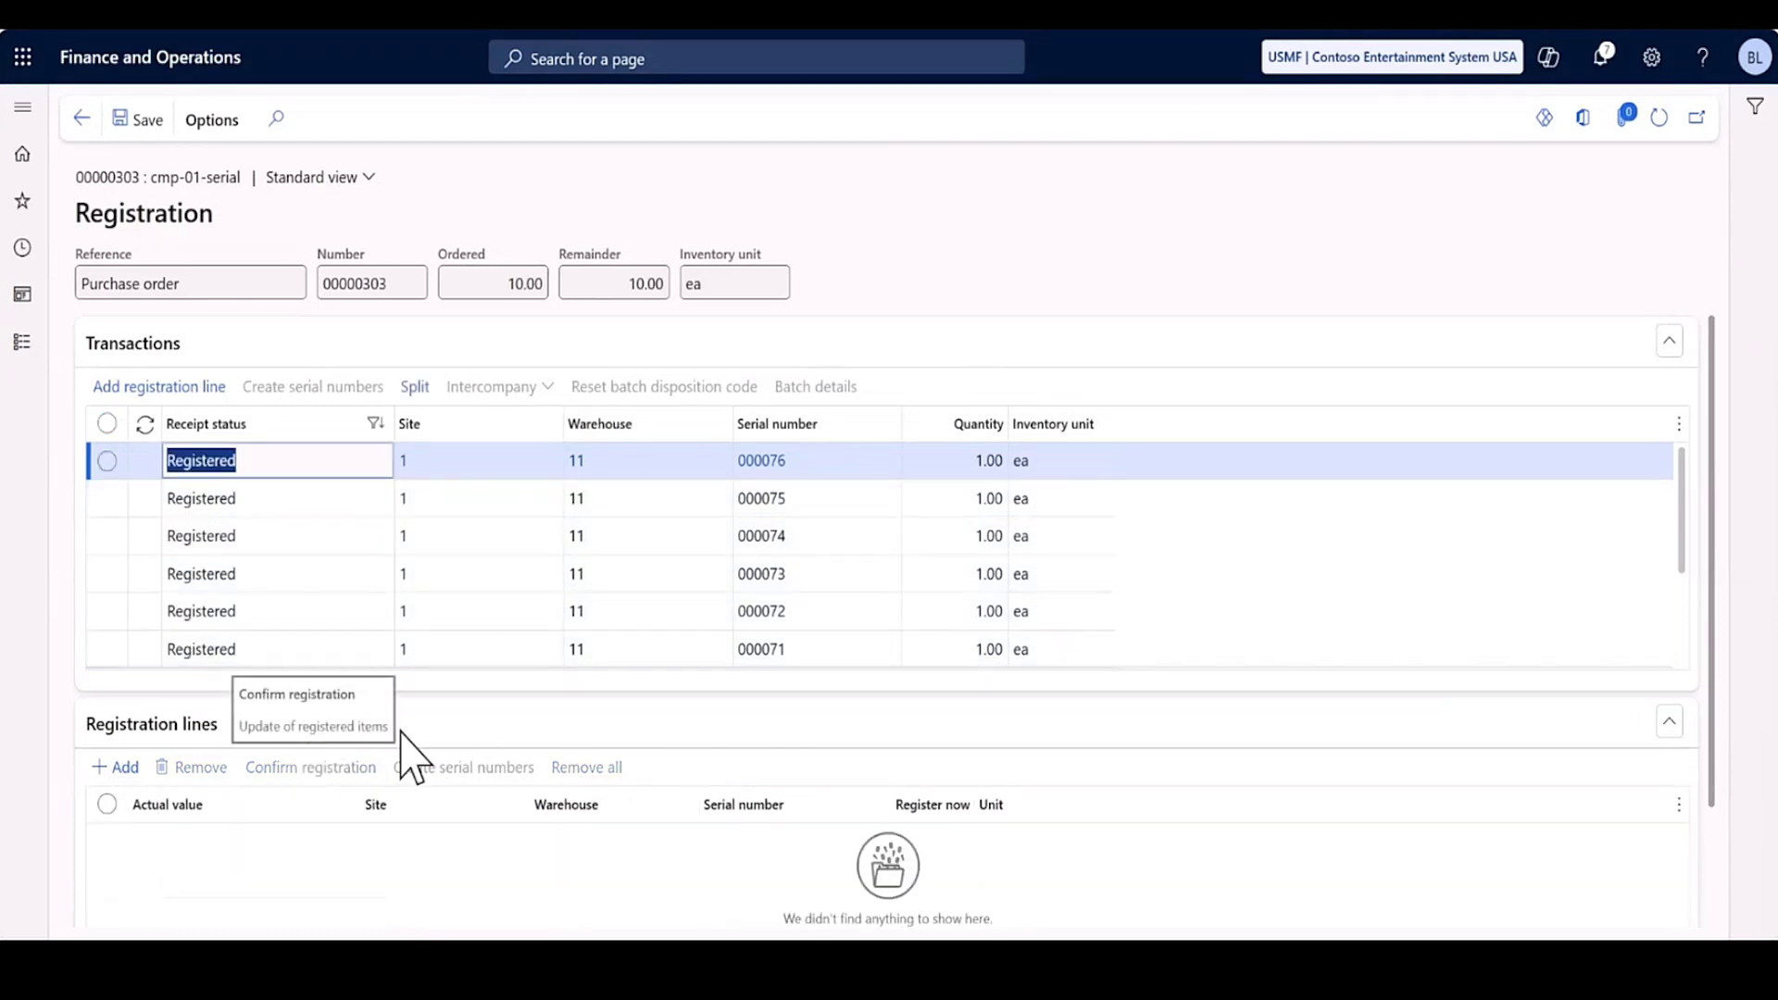

Slide 57
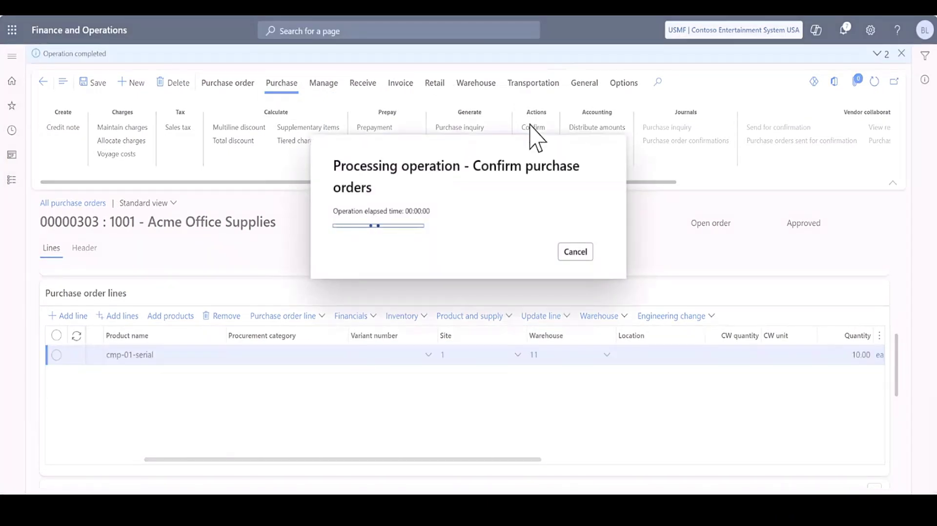

Slide 58
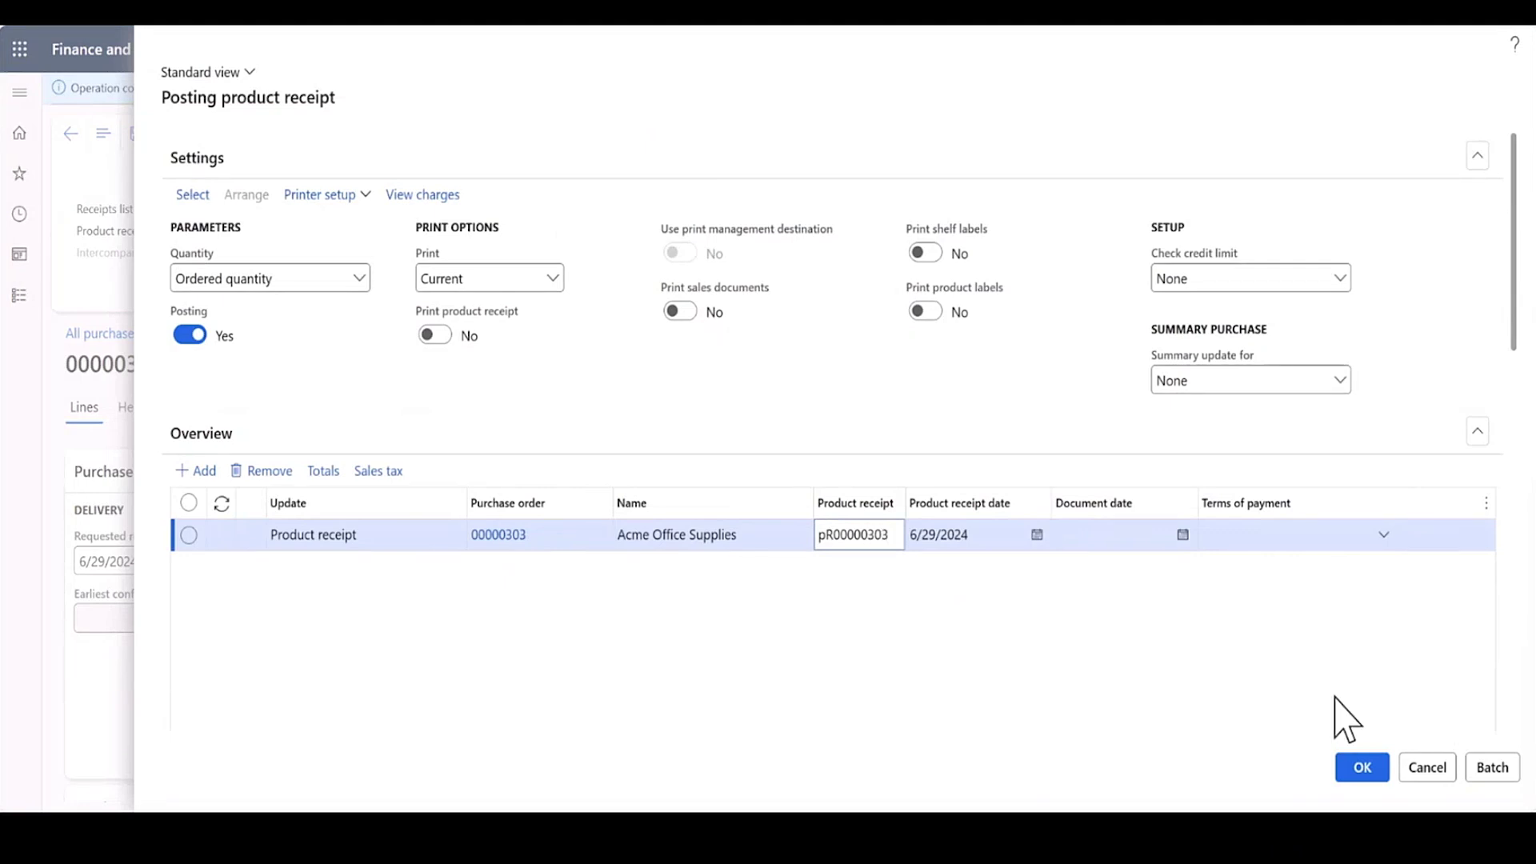

Slide 59
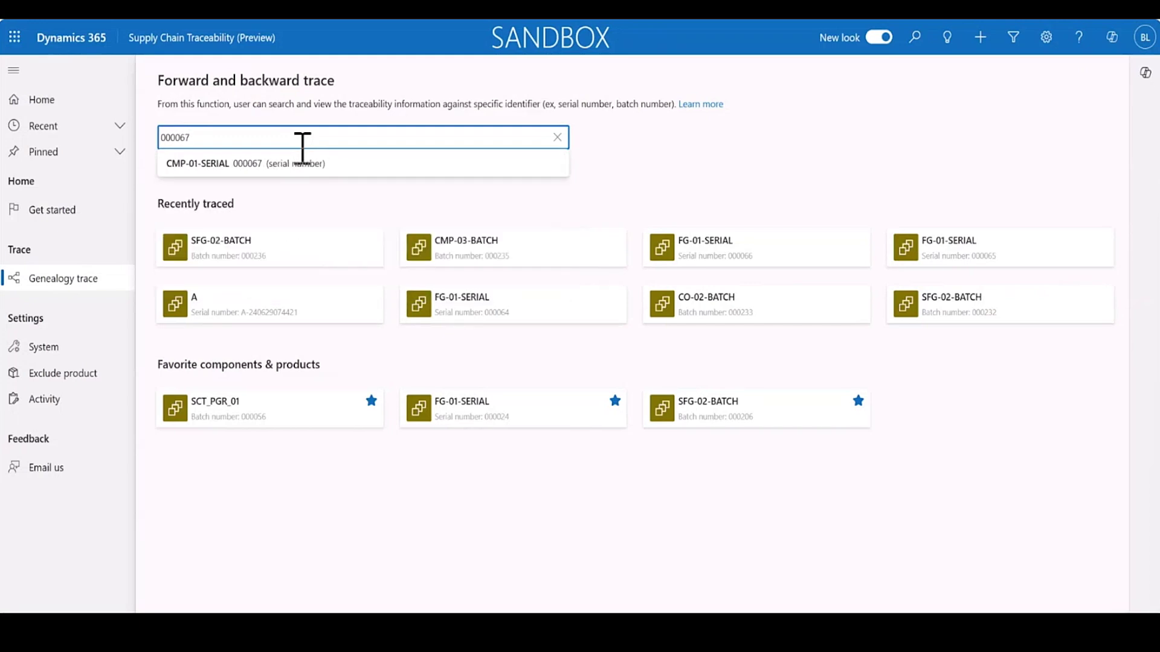

Slide 60
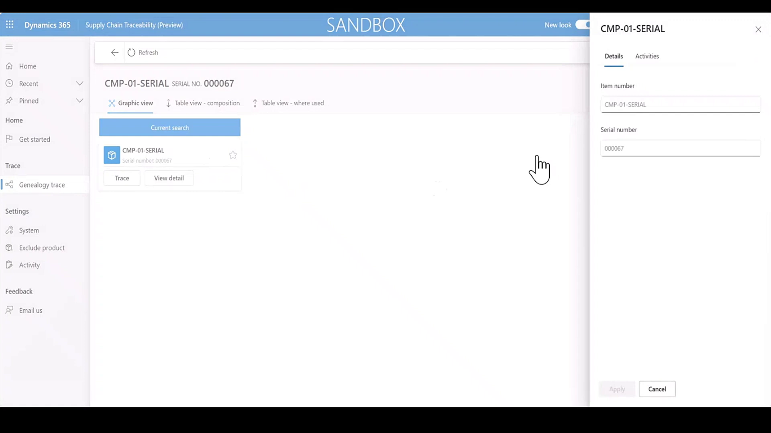

Slide 61
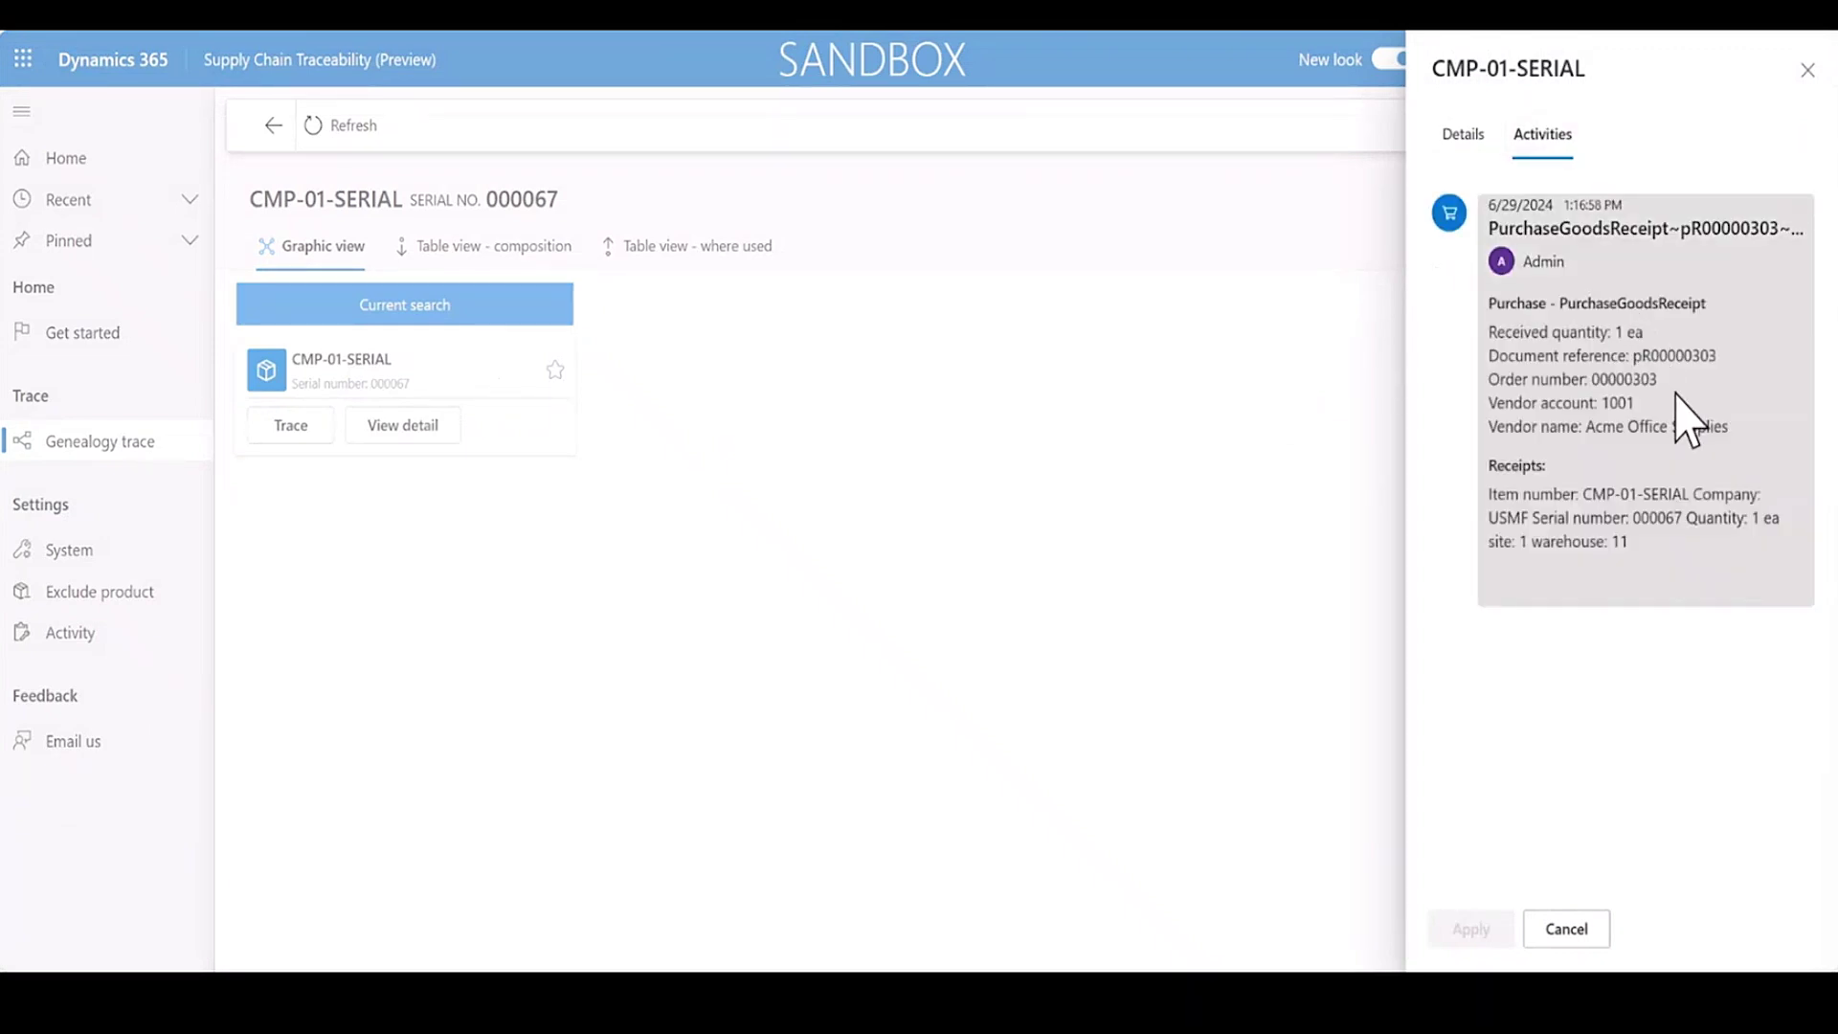

Slide 62
Production
Serial

Slide 63
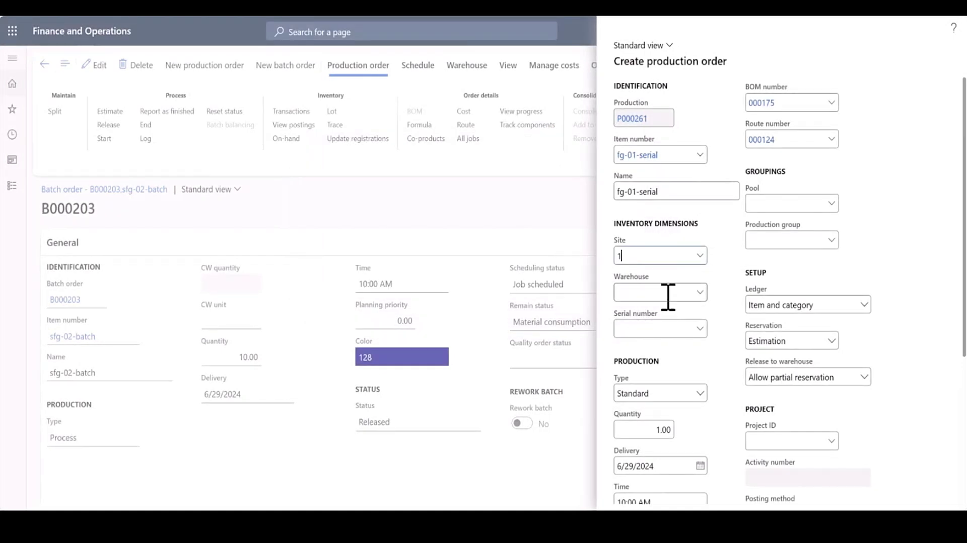

Slide 64
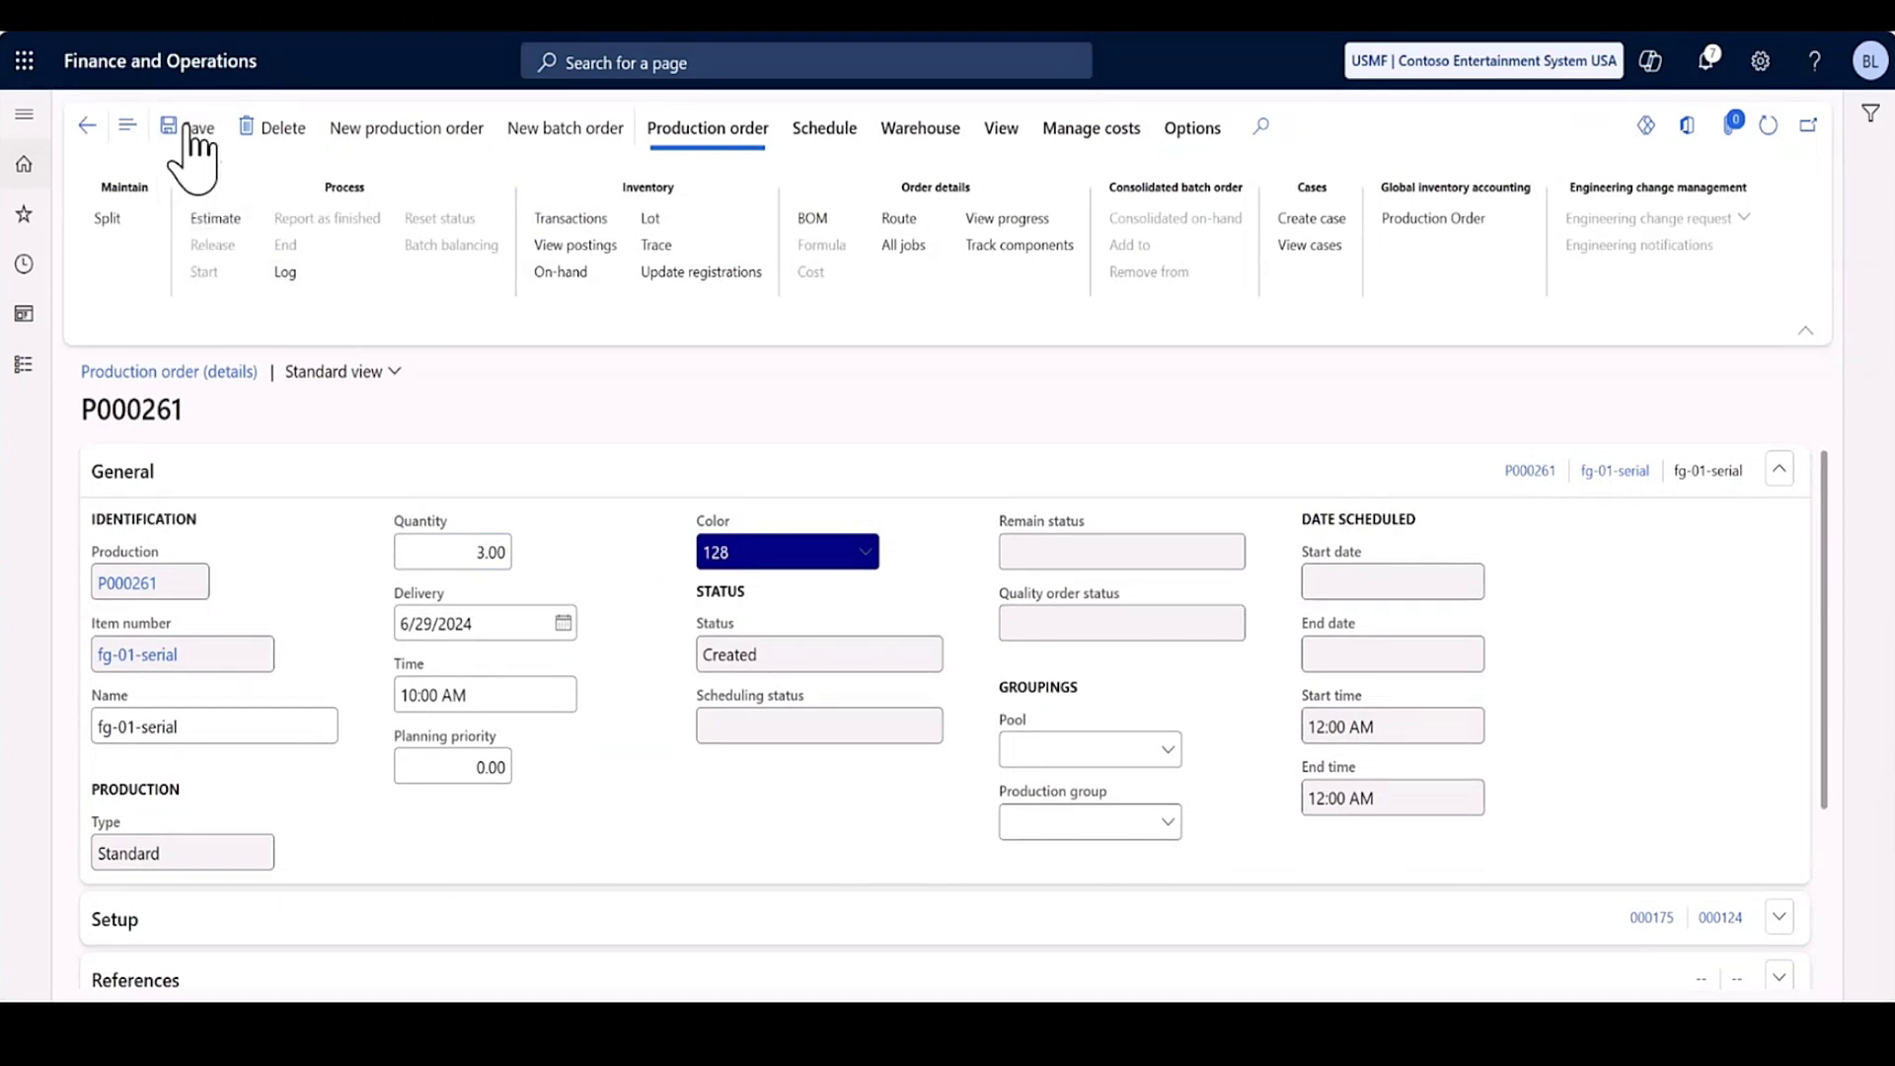

Slide 65


Slide 66


Slide 67


Slide 68


Slide 69


Slide 70


Slide 71

Roadmap

Slide 73

Implementation Considerations
Processes Used – shop floor execution?
System config – Power Platform config

Slide 74


Licensing
“Free” while in preview
Covered by Supply Chain Management Premium Licensing (min 10)
Premium adds some addition consumption and “credits” for other services
100 assets/tenant/month
200 electronic invoice transactions/tenant/month
200 invoice transactions/tenant/month
1K order lines/tenant/month

Slide 75

Still in Preview
Still Evolving
Product Team is still taking feedback and adding features
Interesting

Slide 76


Slide 77
Questions?

